Slide 1
Unit 1 – Exploring Business
Investigate the role and contribution of innovation and enterprise to business success

Slide 2
Investigate the role and contribution of innovation and enterprise to business success
Starter activity

Slide 3
Meet Henry Banks, the inventor of the Torq electronic bicycle lock.
The Torq uses a mechanism that means that the bicycle owner does not need to use a key or numbers to activate the lock. The lock clicks together automatically and can be released by an electronic signal from a key fob.

Slide 4
“I use my bike to get to work and back every day. I found traditional bike locks both tricky to put in place but also occasionally caused me to get my work clothes covered in oil.
“With my car, I just had a simple button on a key fob that I clicked and the door unlocked. I wanted to imitate this idea for my bike.”

Slide 5
“The bike lock is not a new invention nor is the automatic release system. By putting the two ideas together and by keeping the cost low enough to appeal to a mass market I hope to revolutionise the bicycle lock market.”

Slide 6
Ideas can be generated in several ways:
Invention – coming up with a completely unique idea. E.g. Laszlo Biro invented the first ever ball-point pen.
Innovation – adapting a product. E.g. James Dyson altered the vacuum cleaner so that it did not collect dust in a bag.
Imitation – ‘copying’ another idea. E.g. Most supermarkets have their own branded colas.

Slide 7
It’s idea time!
Your team is about to be designated an item that is in every day use. Your task, as a team, is to find an ‘innovative’ new use or an adaptation of the product that will either attract former or new customers to purchase the good. You are allowed to combine your given product with one other product (not from the list that will be shown). You will have 10 minutes to design and prepare to report back.

Slide 8
Your team will be allocated a product from the list below:
Plastic
bottle
Vinyl record
Coat hook
Vintage telephone
Picture frame
Key
fob
Leather belt
Aerosol can
Remember, your task is to find an innovative new use of the product or an innovative way of altering the product to attract new and former customers. You are also allowed to combine the product with one further item to assist your innovation.

Slide 9
You have 10 minutes to prepare a quick presentation on your innovative idea!
Plastic
bottle
Vinyl record
Coat hook
Vintage telephone
Picture frame
Key
fob
Leather belt
Aerosol can
Press space bar to start timer

Slide 10
Let’s hear your ideas!
Plastic
bottle
Vinyl record
Coat hook
Vintage telephone
Picture frame
Key
fob
Leather belt
Aerosol can

Slide 11
What about other businesses?
How have Apple used innovation to contribute to their business success?

Slide 12
Innovation at Apple
In September 2017 Apple announced the launch of the iPhone X, 10 years after the first iPhone revolutionised the mobile phone market
An issue for Apple is how do you continue to innovate a product that has already seen so many advances over that 10-year period? What can you add to the product to entice people to purchase an iPhone for the first time or upgrade their existing model? Are the current phones sufficient to meet the needs of the existing customers?

Slide 13
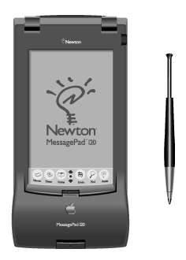
The development of the iPhone
This is a Newton MessagePad. Apple were the market leaders in developing handheld devices that could be used to improve workflow.

Slide 14
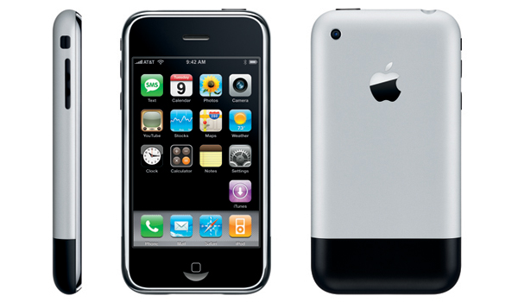
The development of the iPhone
Apple took this technology and made it more useful by adding telephone communication systems

Slide 15
The development of the iPhone
Over a 10 year period the iPhone was continually altered to give it a new look and new functionality until…..

Slide 16
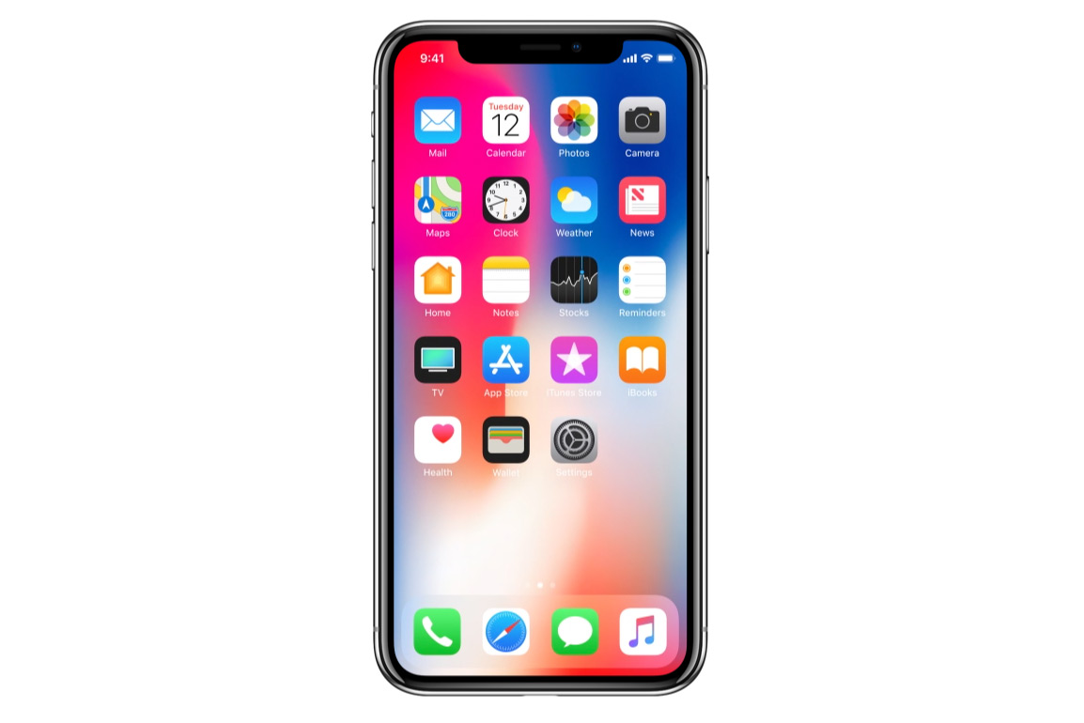
The iPhone X (product details)
Face ID removes need for home button
OLED display (higher definition)
Improved cameras
Screen stretches across the entire front
Improved build quality (both glass and metal case)
Improved battery life (extra 2 hours)
Wireless charging

Slide 17
Innovation at Apple
TASK 1
What new features would the smartphone of the future have? Imagine a smartphone (like the iPhone) in 10 years time.
List three features that you think the phone could have (that it doesn’t have already!) and explain the issues/problems that it solves or the advantage that it adds to the device.

Slide 18
Innovation at Apple
TASK 2
Using the worksheet provided, answer the following questions on Apple Product Innovation:
Name four major competitors for Apple in the mobile phone market.
In what ways has the iPhone developed since the original version in 2007?
How does Apple’s continual innovation help the company to be successful?
What makes the iPhone stand out from its competitors?
In what ways have customer expectations of mobile phones changed over the last 10 years?

Slide 19
Innovation in Apple Retail Stores
Innovation is not exclusively linked to products. Apple have been very innovative in how they deliver customer service and the whole shopping experience at their stores.

Slide 20
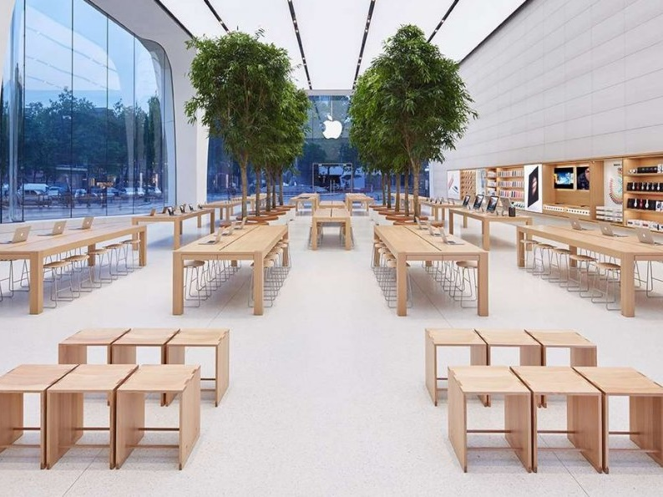
Innovation in the Apple Retail Store
Watch this video on Apple Customer Service:
Click on the film icon or visit
https://www.youtube.com/watch?v=aQ7hm7rXnRY

Slide 21
Innovation in Apple Retail Stores
TASK 3
Using the worksheet provided, answer the following questions on innovation in Apple Stores:
How has innovation in customer services helped Apple to be successful?
In what ways is shopping at an Apple Store different to shopping at other technology stores (e.g. Curry’s)?

Slide 22
Innovation in the Apple Retail Store
Watch this video on Apple Store Design:
Click on the film icon or visit
https://www.youtube.com/watch?v=-AkLOvjl5jo&t=119s

Slide 23
Innovation in Apple Retail Stores
TASK 4
Using the worksheet provided, answer the following question on innovation in Apple Stores:
What evidence is there that Apple has attempted to be sympathetic to the environment of places where they have located their stores?
What are the risks of competing in a retail market?

Slide 24
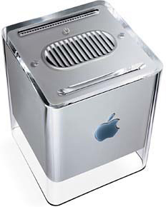
Apple’s ‘failures’
This is an Apple ‘Power Cube’. It was on sale between 2000 and 2001. It was a small PC that could be plugged in to a TV and used as a computer. It had no in-built speakers and there was no capacity to input audio. Production was stopped in 2001 due to poor sales.

Slide 25
Apple’s ‘failures’
What does the failure of the Apple Cube indicate about the dangers of continually innovating products?

Slide 26
Innovation in Apple Retail Stores
TASK 5
What are the risks for companies like Apple when the continually develop new versions of existing devices?

