Slide 1
Do you consider yourself a budding entrepreneur?
You are going to plan a business idea, which you will develop further.

Slide 2
You need to get your creative, thinking hats on...but here are some ideas to help...

Slide 3
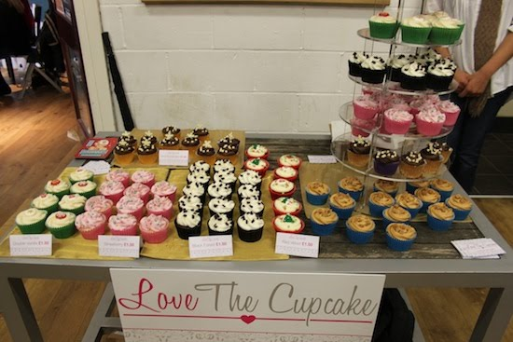
Potential business ideas
Could you start a cup cake production company?

Slide 4
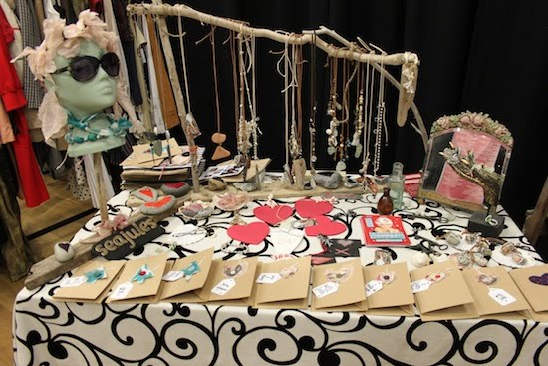
Potential business ideas
Or how about a jewellery or craft stall?

Slide 5
Potential business ideas
Any budding IT geeks capable of designing an app?

Slide 6
Potential business ideas
Any gifted and talented sports people think they could run training sessions?

Slide 7
Potential business ideas
How about starting a school magazine?

Slide 8
Budget
You have a start-up budget of £300 – so you need to start small.

Slide 9
First, you need an initial business idea.
Once you have your idea – you can work on the following tasks in any order.
You need a brand identity – that’s a name, logo, slogan etc
You need ideas for how you can promote your business.
You need to design your product – something visual people can see.
You need a price.
You need to think about WHO will buy your product – who are you aiming at? Age/gender/hobbies etc.

Slide 10
Presentations
You should to put together a presentation about your potential business idea as if you are going to the Dragons Den

