Slide 1
Market segments
An identifiable group of people with the similar characteristics.

Slide 2
What might consumers have in common?
Ethnicity
Gender
Socio-economic groups
Age
Hobbies
Lifestyle
Religion
Location
Income

Slide 3
Socio-economic groups
Class | Social Status | Head of household’s occupation
A | Upper middle class | Higher managerial, administrative or professional e.g. doctors, lawyers & company directors.
B | Middle Class | Intermediate managerial, administrative or professional e.g. teachers, nurses or managers.
C1 | Lower Middle Class | Supervisory or clerical, junior managerial or professional e.g. shop assistants, clerks & police officers.
C2 | Skilled Working Class | Skilled manual workers e.g. carpenters, cooks & train drivers
D | Working Class | Semi-skilled and unskilled manual workers e.g. fitters & store keepers.
E | The Poorest in Society | State pensioners, casual or lower grade workers or the long term unemployed e.g. Cleaners.

Slide 4
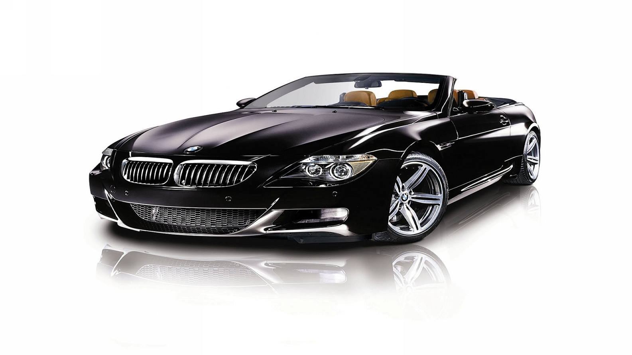
Who would buy this car?
Is the person who owns this car a male or a female?
How old is the person who owns this car?
What job do they do and how much do they earn?
Where do they live and what type of house do they live in?
What are their hobbies?
What programmes does this person watch on television?
What newspapers / magazines does this person read?
Where might this car be advertised?

Slide 5
Why do you need to know your customer?
Plan a more targeted advertising campaign
Understand what products they like for future ideas
Understand how much they can afford
Know how to distribute/where to locate
& for much much more......
Target market is boys and girls aged 2-5 years old.

Slide 6
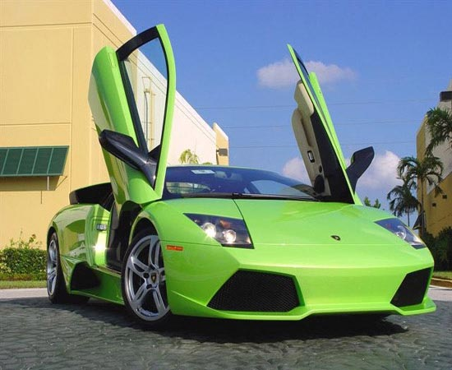
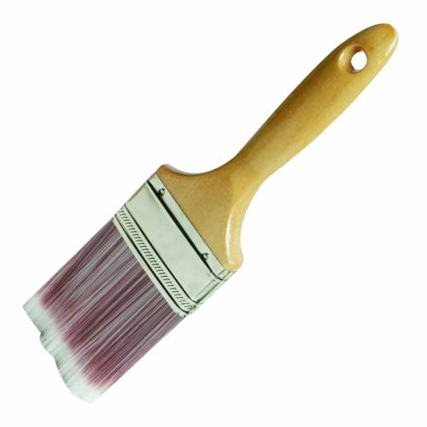
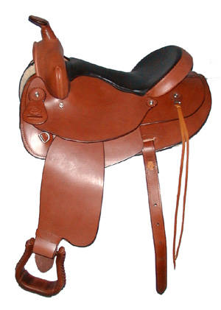
Who is your consumer?

