Slide 1
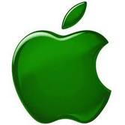
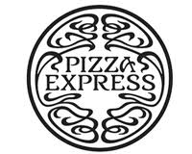
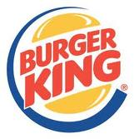
Branding & Differentiation

Slide 2
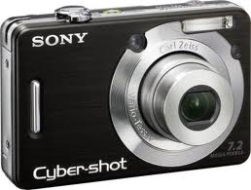
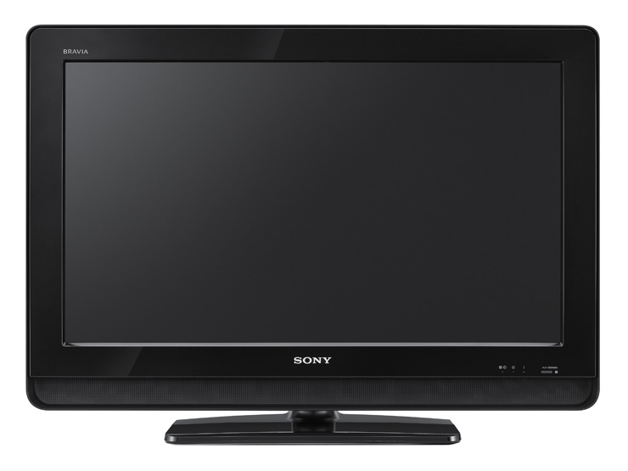
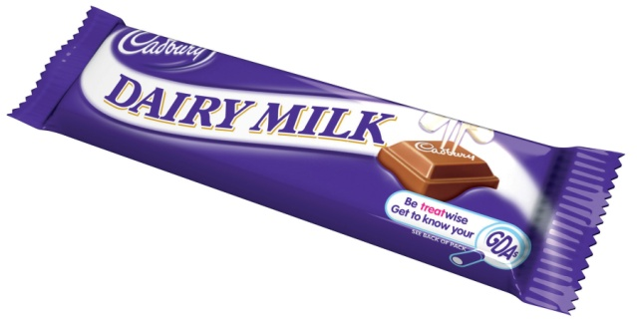
Branding gives an identity to a product.
Every business wants to be a customer’s first choice. Building a brand can make that happen. A brand can be a particular product or a company name.

Slide 3
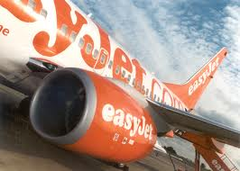
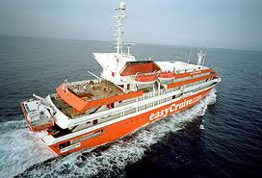
Types of branding
Family Branding
Where products are distinguished under a company heading.

Slide 4
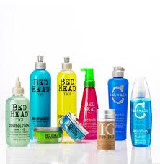
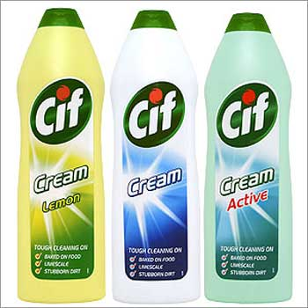
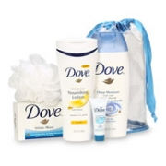
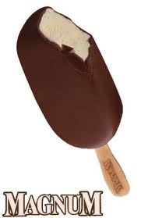
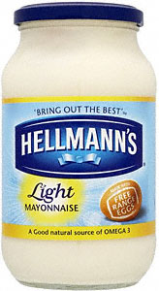
Types of branding
Line Branding.
Products are distinguished from other products within the same business.
All these brands are owned by 1 company – Unilever.

Slide 5
Advantages of strong branding
It encourages customer loyalty.
Companies are able to charge higher prices.
Retailers want to stock top-selling brands.

Slide 6
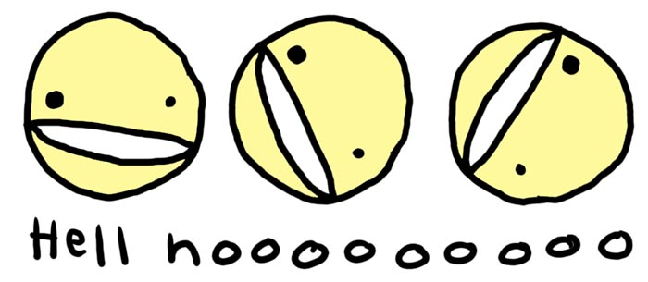
Disadvantages of strong branding
Higher promotion costs to gain recognition.
Constant promotion
is necessary.
A single bad event may affect all products.
Brand names have to be protected by being registered worldwide.

Slide 7
Differentiation
There are several ways in which businesses can differentiate their product from their competition:
Logo
Name
Quality
Content
Packaging
Design
A unique selling point is when an a product has an important feature that other products do not have. Having a USP is the ultimate form of product differentiation.

