Slide 1
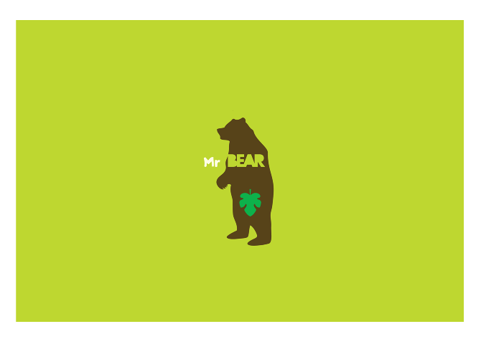
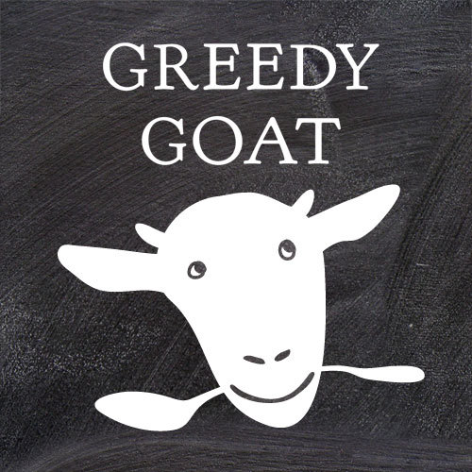
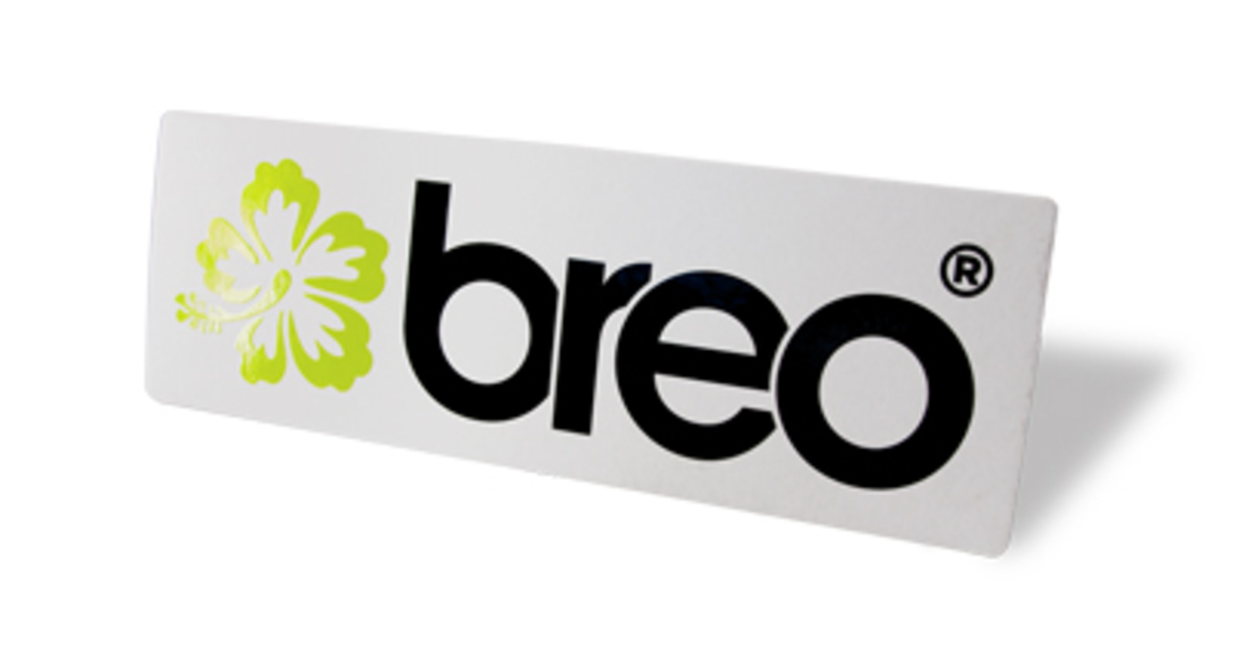
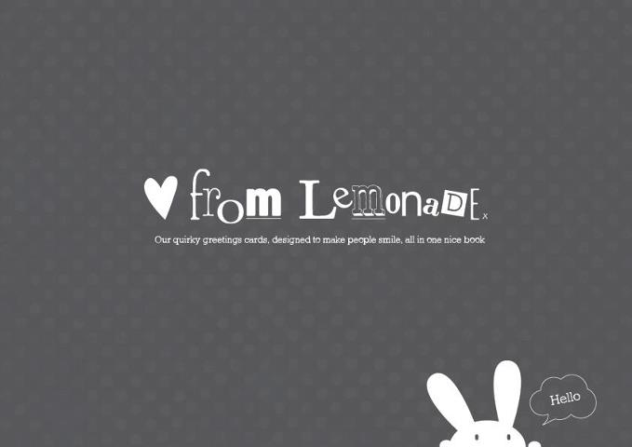
Branding

Slide 2
What businesses do you think of when you see this colour?

Slide 3
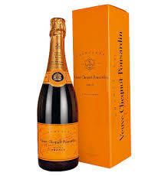
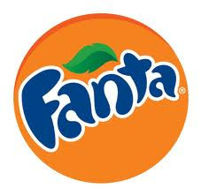
What businesses do you think of when you see this colour?

Slide 4
What about this one?

Slide 5
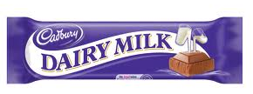
What about this one?

Slide 6
And this one?

Slide 7
And this one?

Slide 8
Can you name these brands?

Slide 9
Can you name these brands?

Slide 10
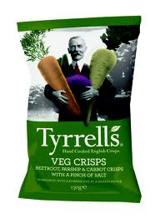
Can you name these brands?

Slide 11
Can you name these brands?

Slide 12
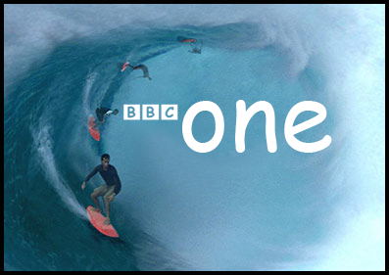
What’s wrong with the BBC logo?

Slide 13
The font

Slide 14
In October 2010, gap changed their logo……for about a week!
Notes:
http://www.bbc.co.uk/news/business-11520930

Slide 15
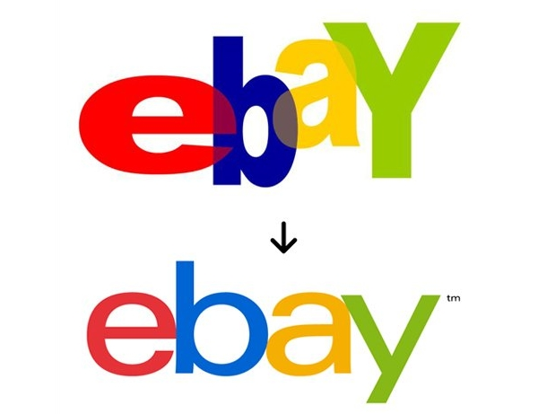
Why do you think ebay changed their logo?
from this
to this

Slide 16
Why do you think Thomas Cook changed their logo?
from this
to this

