Slide 1
International women's day
Monday 8th March 2021

Slide 2
What is international women’s day?
It is a day for celebrating social, economic, cultural and political achievements of women.
It is also a very important day to raise awareness about equality and fundraise for female-focused charities.

Slide 3
This years theme:
This years theme is ‘choose to challenge.’
We are responsible for our actions and thoughts. We can choose to call out any gender bias or inequality.
The purpose of IWD is provide a platform for those making a positive change to women and their rights.

Slide 4
Video on international women’s day
This video explores the significance of International Women’s day and why it so important.
What Is International Women's Day? – YouTube

Slide 5
What we can do to help?
There are many ways we can get involved. These include: signing petitions, donating to fundraisers and learning more about the issues.
Here are two things you can do today to support women’s rights
Petition · Make Public Sexual Harassment a Criminal Offence in the UK · Change.org
https://www.refugeewomen.co.uk/stop-the-new-detention-centre/

Slide 6
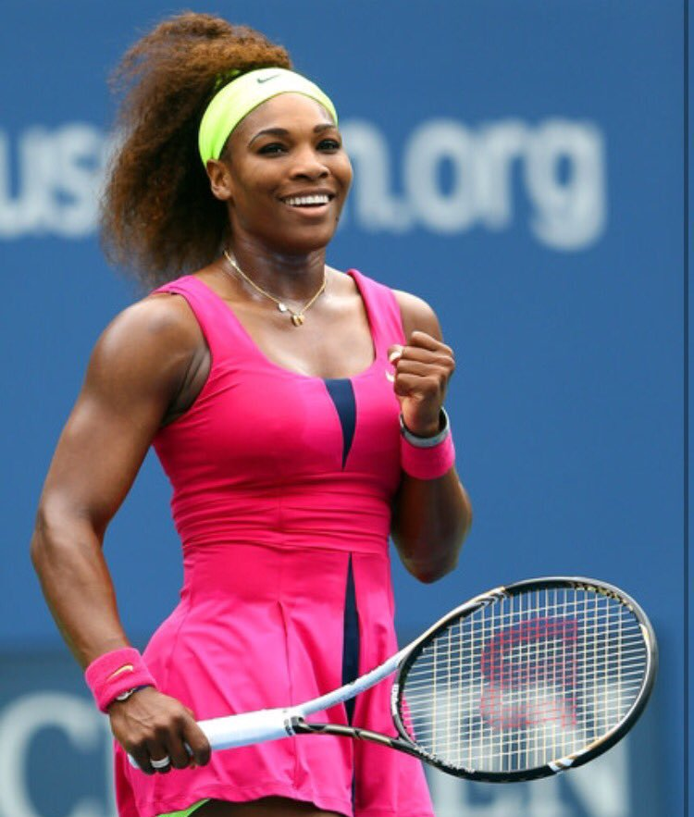
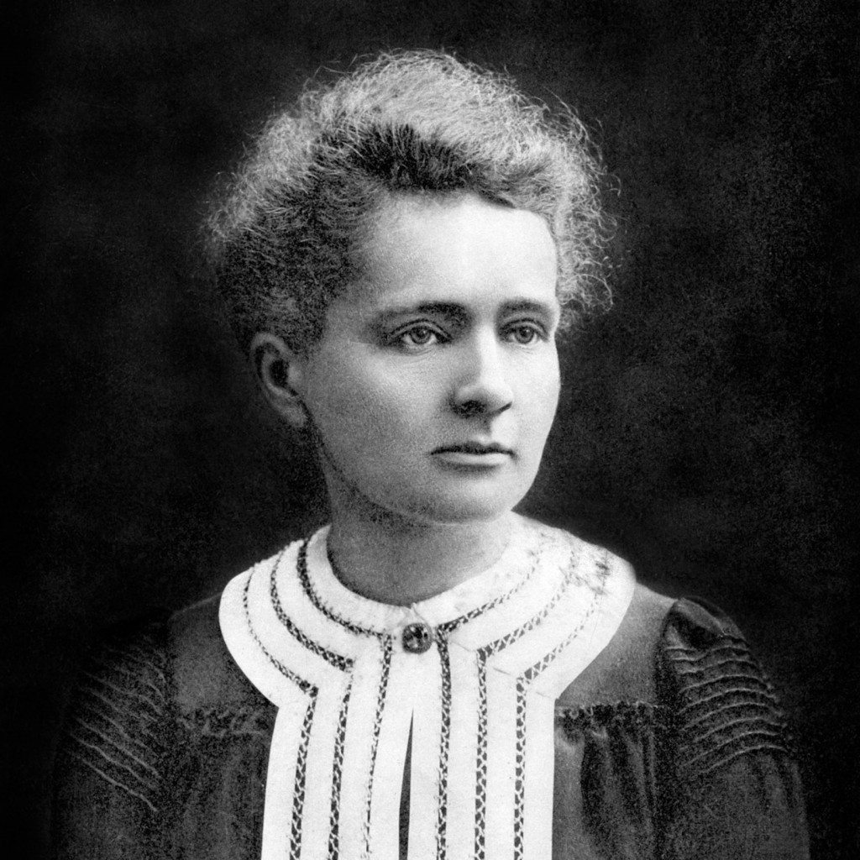
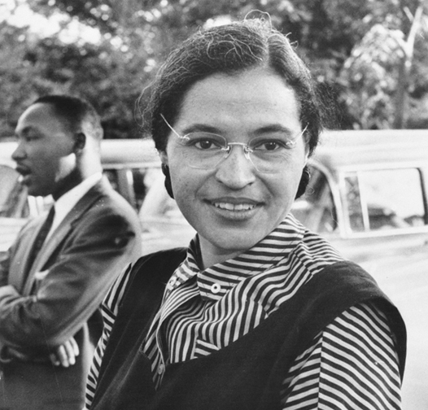
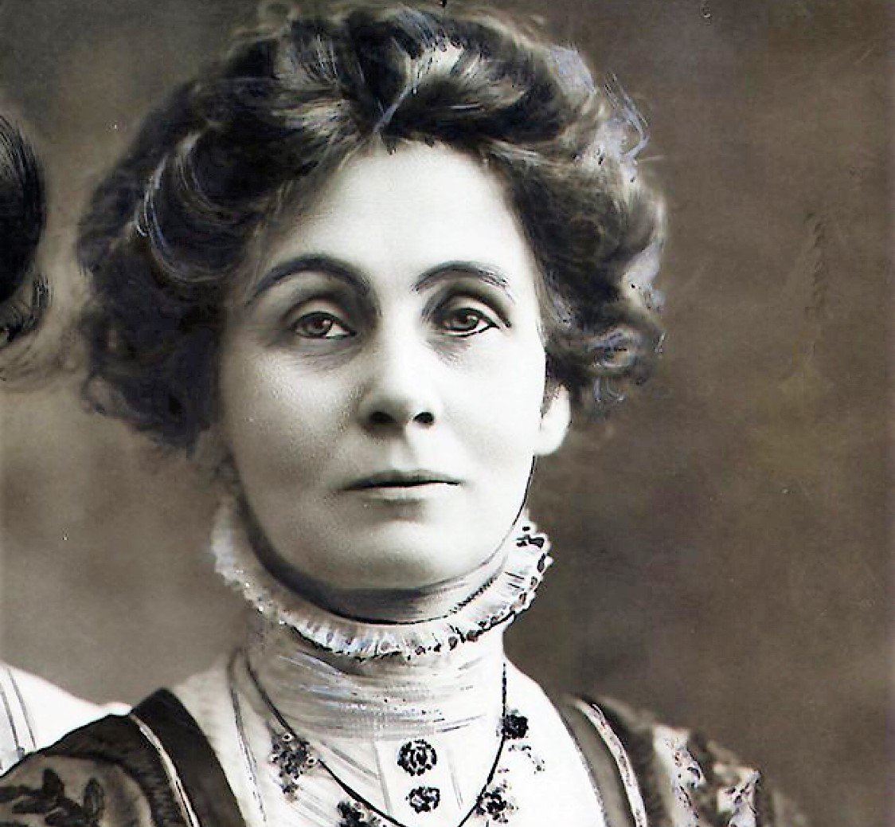
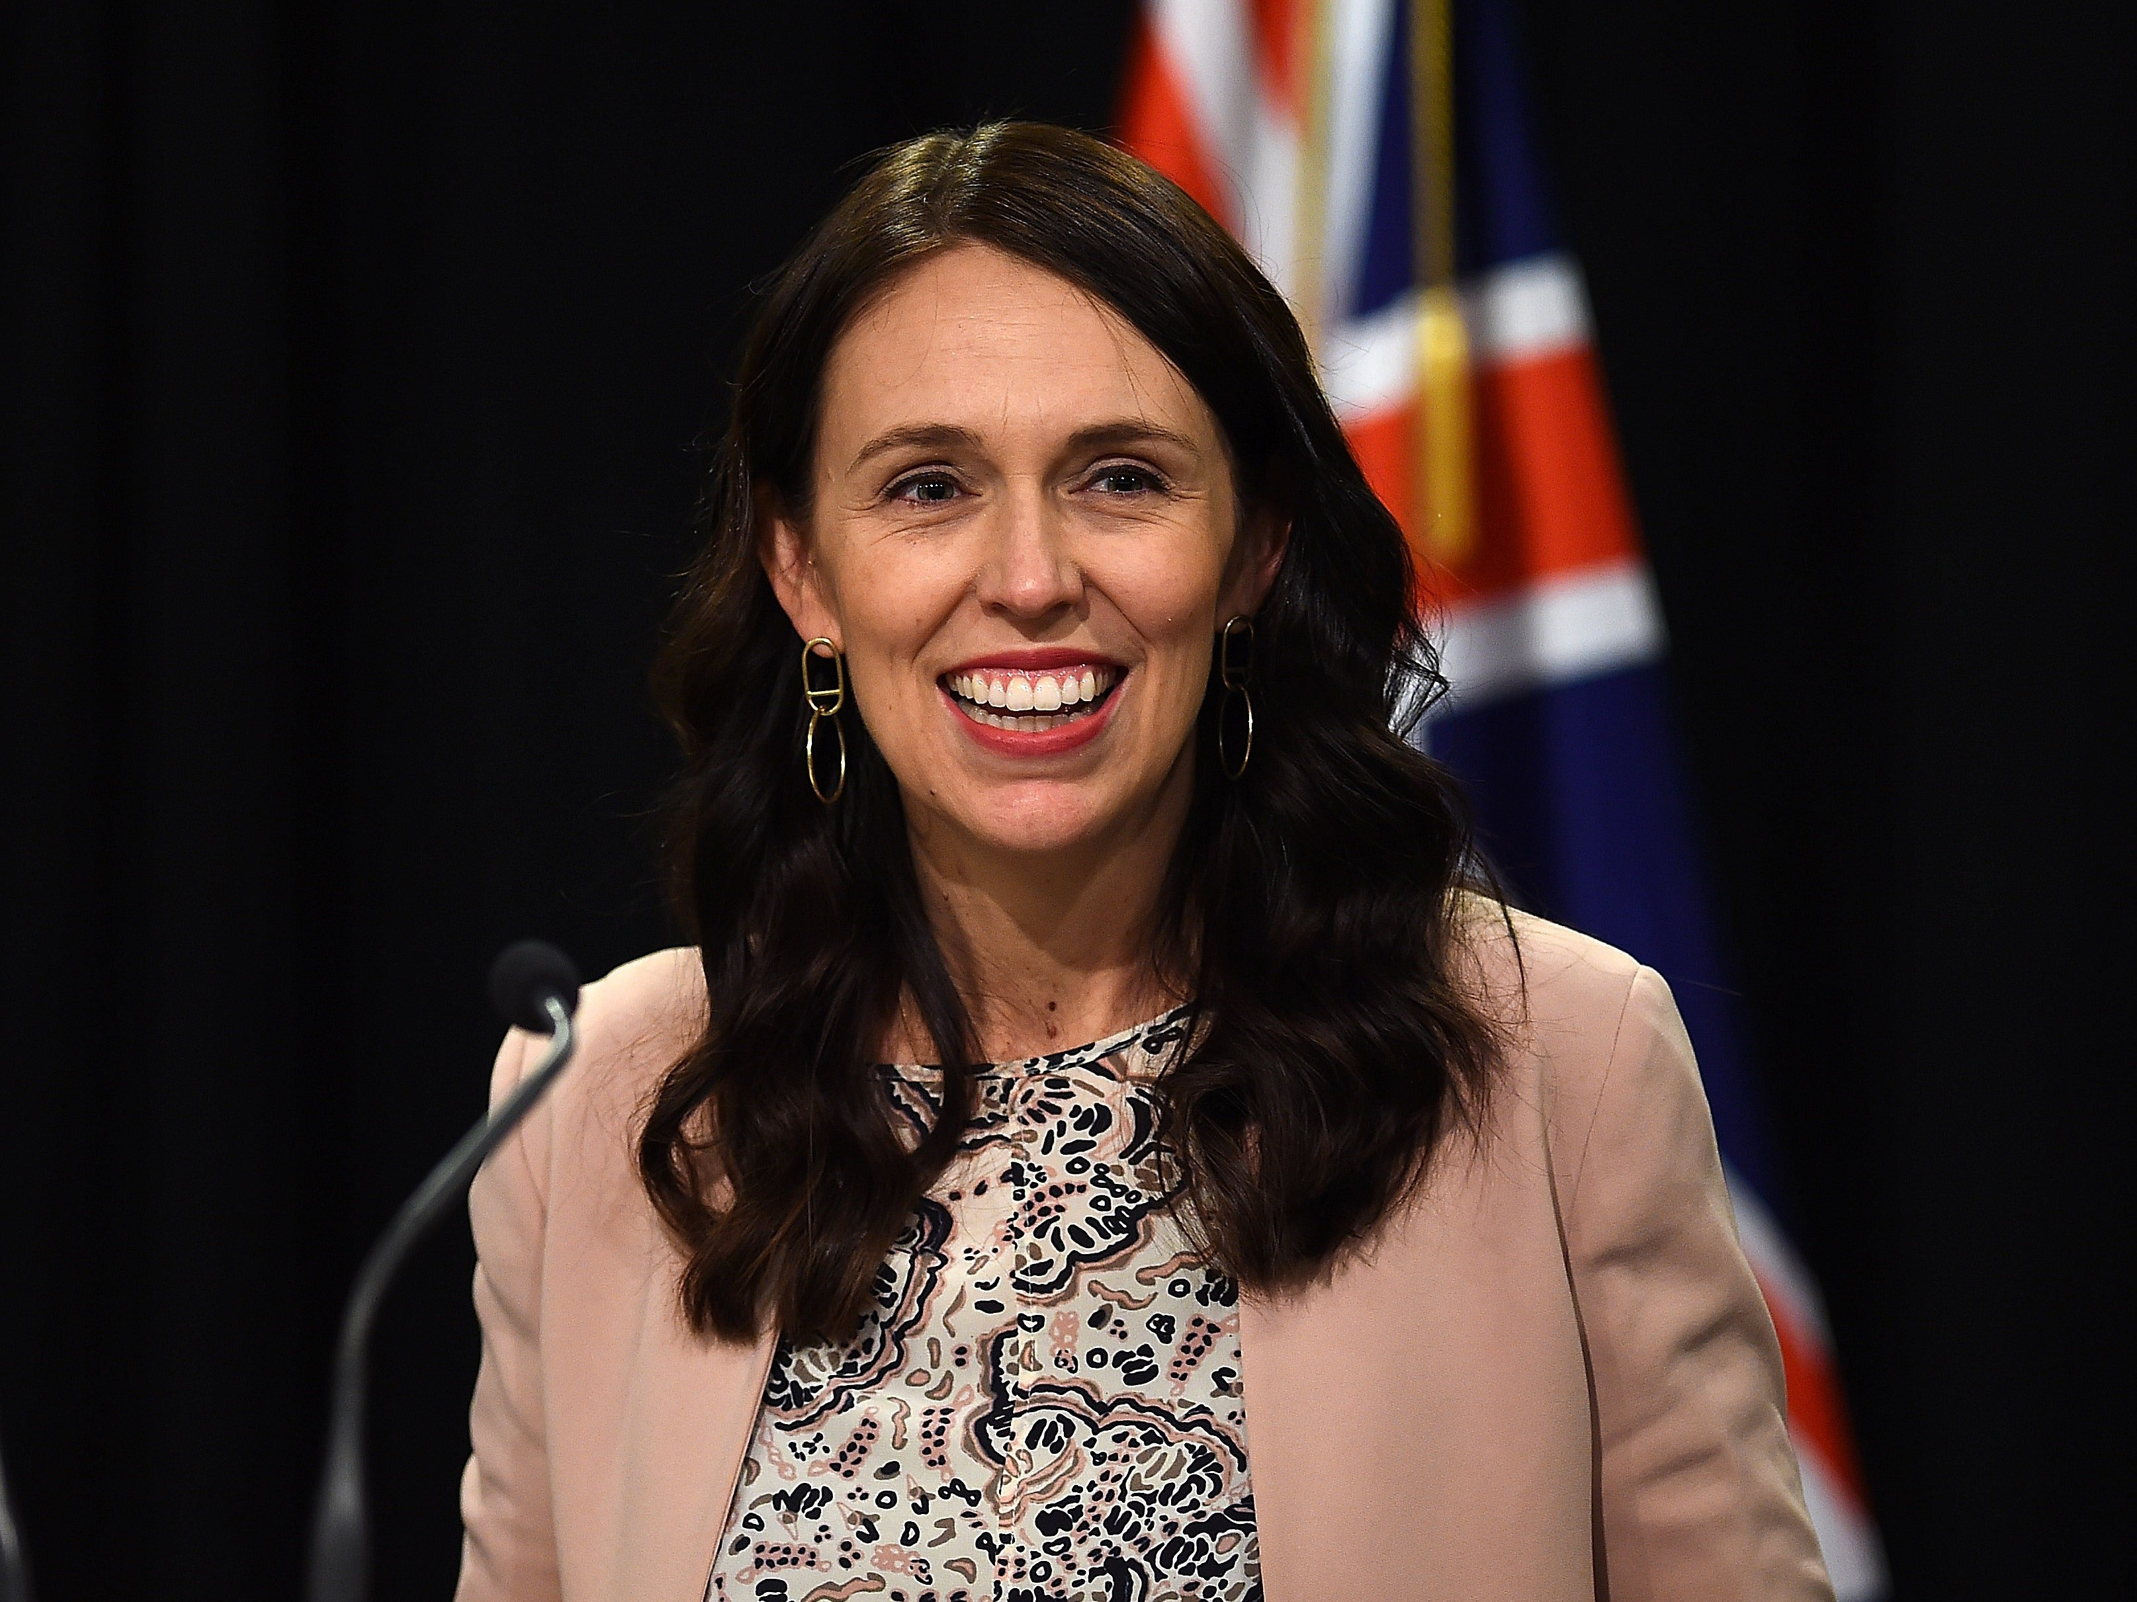
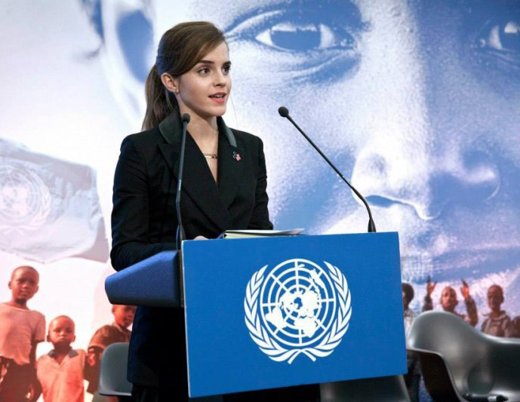
Name these Inspirational women
1.
2.
3.
4.
5.
6.
7.
8.
9.
10.

Slide 7
Answers:
Serena Williams 6. Taylor Swift
Malala Yousafzai 7. Emmeline Pankhurst
Marie Curie 8. Jacinda Ardern
Rosa Parks 9. Emma Watson
Greta Thunberg 10. Michelle Obama

Slide 8
QEHS Human Rights group
The Human Rights Group is meeting virtually after school on Mondays on Teams at the moment. If you’d like to come along, send Mr Jones an email (djones@qehs.net) and he’ll add you to the group.

