Slide 1

How to do just about anything…
Involving school computer systems…
Click Start to Begin
Start

Slide 2
Contents- Click to go to the page
In school:
Fair use policy
Logging onto a school computer
Saving work to your school drive
Accessing Moodle.
Remote Learning/Access:
Emails
Accessing emails through Outlook
Accessing Office (start here)
Teams
Joining Meetings
Assignments
Class files
Class notebook.
OneDrive
General Advice
Coming soon…

Slide 3
Fair use policy
It is important to know that the school monitors the use of all computers in school, as well as all email traffic sent and received from a school email address. As such all your usage is visible and school systems should only be used for school business and not personal uses.
Every time you log in you will be asked to accept the User Agreement.
Back to Contents

Slide 4
Logging into school computers
To log into the school computers, you use your student login. This will be a number beginning with the year you started the school. For example, the year 9s that joined in 2021 will have a code of 210xxx.
Your default password is your date of birth with 8 digits, e.g. 26092021
If you changed your password (which you should!) and have forgotten it, you will need to ask your teacher to request a reset.
Back to Contents

Slide 5
Saving your work to your school drive
You are able to save your work to the school network. As we now have access to OneDrive, this is less common, but should still be done correctly. When saving make sure you use the drive that starts with your student login number.
Save all your work with a sensible file name, in a folder for that subject.
Back to Contents

Slide 6
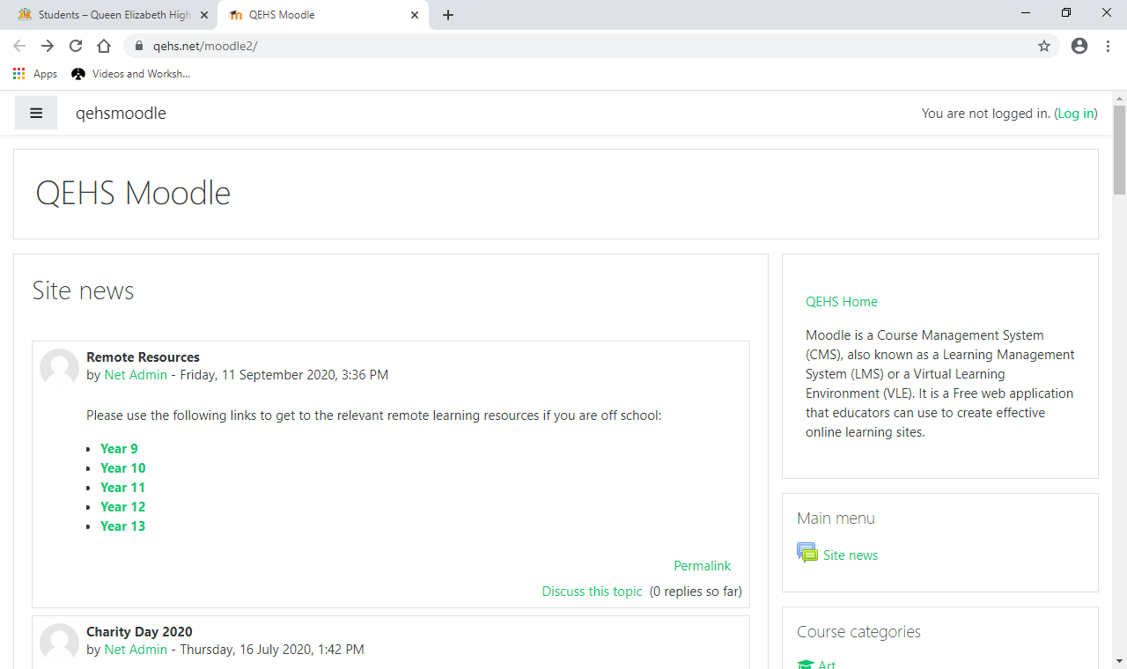
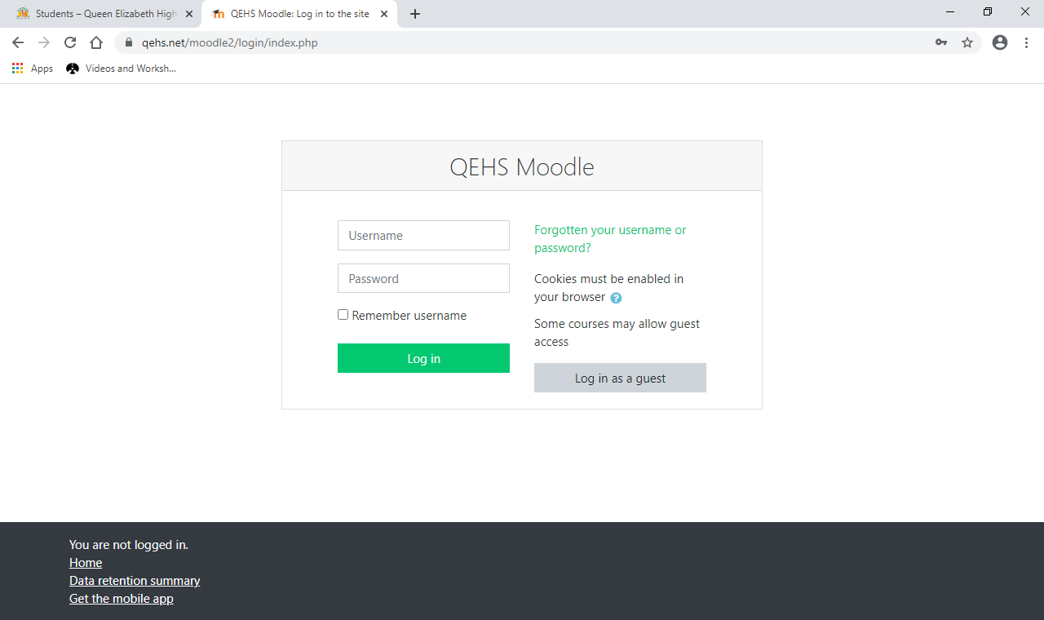
Accessing Moodle
Moodle is our Virtual Learning Environment (VLE). While a lot of departments use Teams, some have a huge amount of useful resources on Moddle.
To access it go to the school website: www.qehs.net and click ‘Students’ at the top of the page
Scroll down and click on Moodle.
Click Log in at the top of the page and follow the instructions to login. Your teacher will explain how to access the relevant courses.
Use your school network login
Use your school network password
Back to Contents

Slide 7
School emails
Every QEHS student has a school email. This is used to access office.com, which includes access to teams and other Microsoft apps. You may also use it to access other websites for school, for example, Dr. Frost Maths.
Your school email is your school login followed by @qehs.net for example 210xxx@qehs.net
The password is the same as your school login password, by default your date of birth with 8 digits (e.g. 26092021)
You can access your emails, and send your own by going to office.com (instructions here) and going to the Outlook app.
Remember, all school emails are monitored by the school.
When sending an email try to keep a certain amount of formality, so make sure to include a brief message subject and have an introduction and goodbye, for example
Hello Mr. X
This is my important message.
Thanks very much
A. Student
Back to Contents

Slide 8

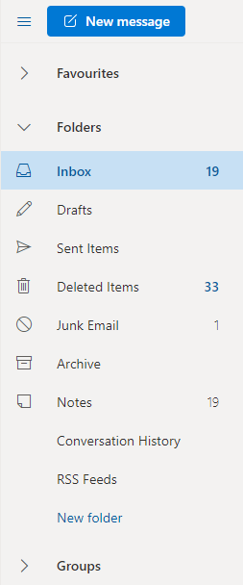
Accessing emails from Outlook
To access your emails, go to office.com (instructions here) and click the Outlook icon. This is the email app.
In the main window, you can see your emails and click on them to read.
To write a new email, click ‘New message’
You can search for a member of the school by clicking ‘To’
Remember to be polite and professional.
If you receive spam or a nasty email, please inform your teacher as soon as possible.
Back to Contents

Slide 9
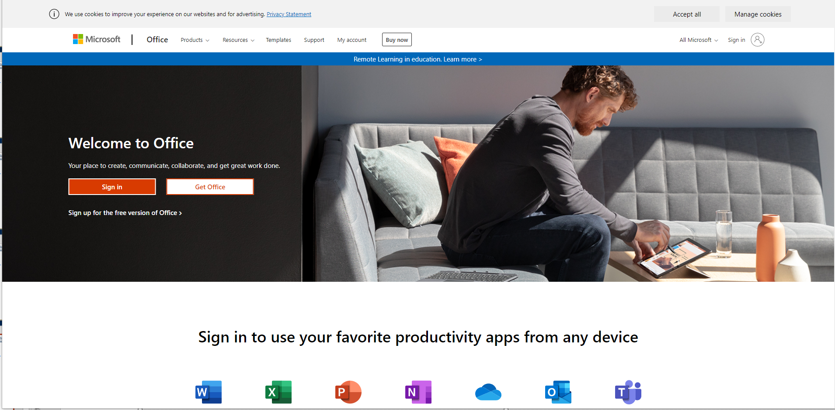
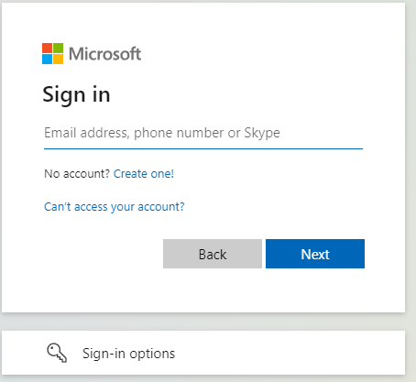
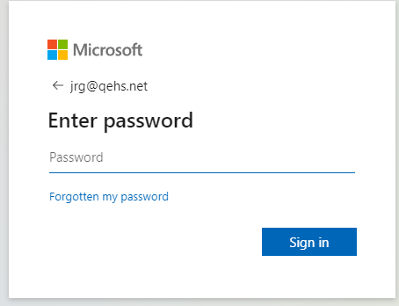
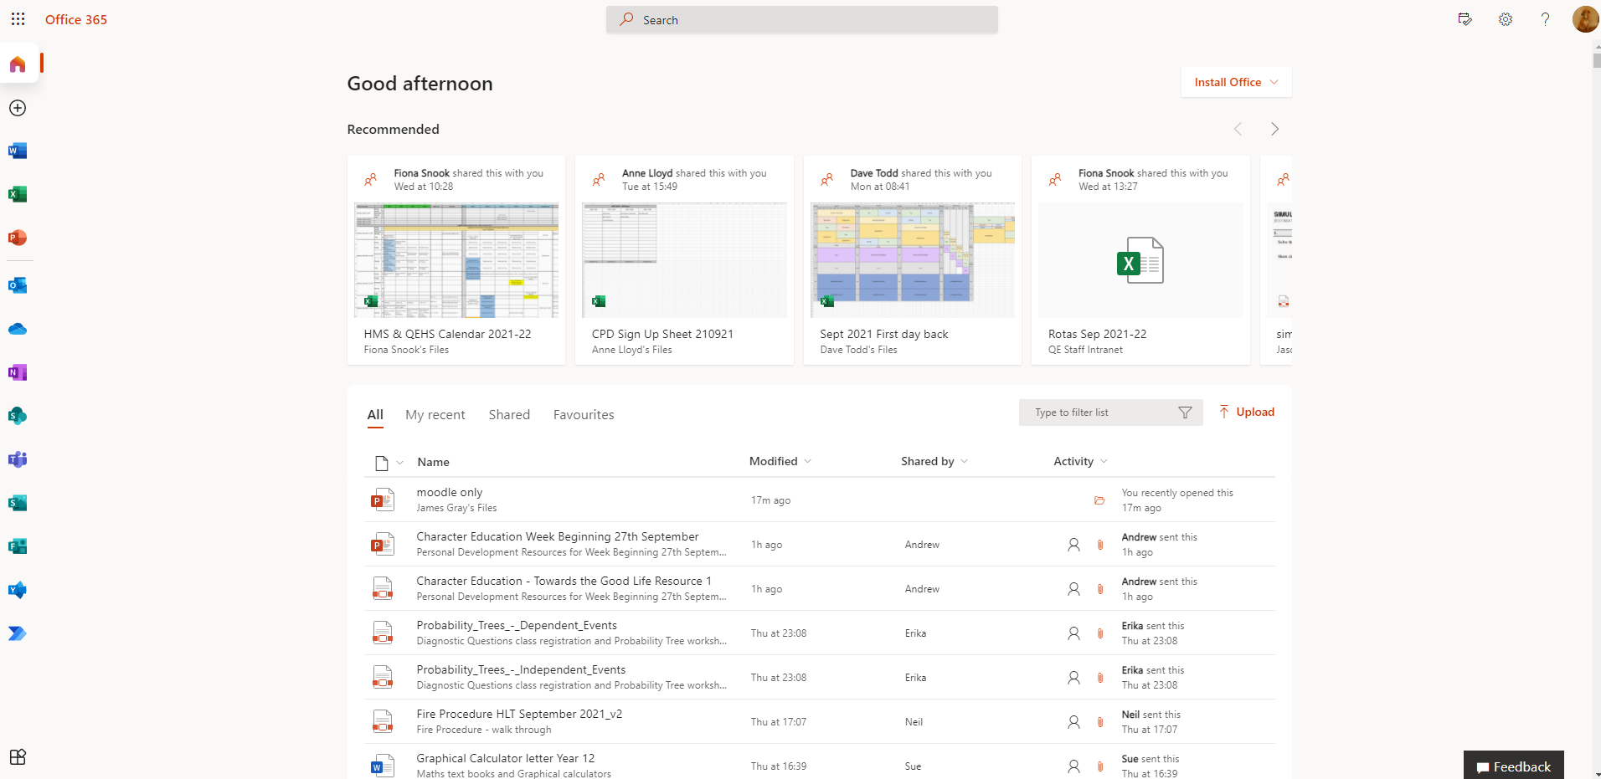
Accessing Office.com
1
All of your basic office apps can be found at office.com
To login, click ‘sign in’
Enter your school email, followed by your school password
On the left are many apps you will need, including Word, PowerPoint, Excel, Teams and Outlook (for email) and OneDrive (for saving work)
You can also install these apps on your home computer
2
3
Back to Contents

Slide 10

Accessing Teams
From office.com you can click on the Teams icon to access the web version of Teams. If you are asked to login, use your school email and password
You may be asked if you want to download the Teams app. This tends to work slightly better but is not compulsory.
Back to Contents

Slide 11

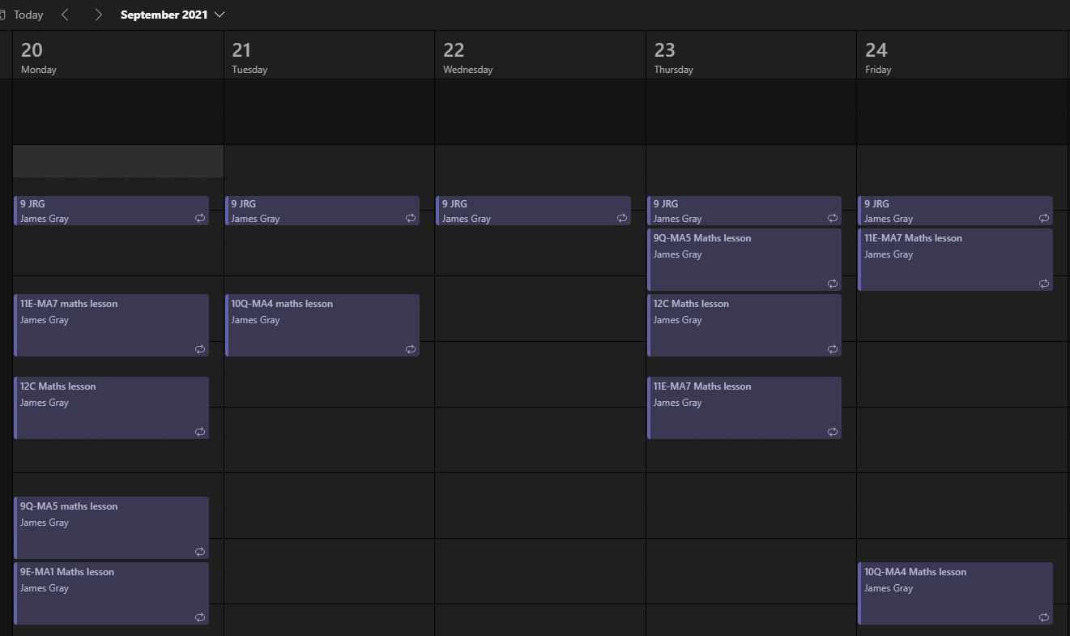
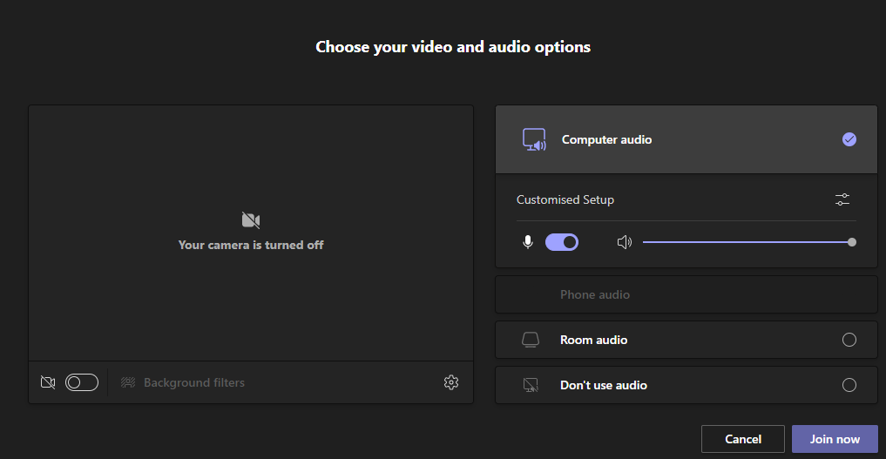
Meetings in Teams
Most meetings you will be asked to join can be accessed from the calendar tab on the side of the screen.
To access a meeting, click the lesson and choose join
Make sure your camera and mic are turned off. You can choose different sound sources (e.g. built in speaker or Bluetooth headset) by clicking the button next to customised setup.
In the meeting you will be expected to contribute, possibly through the chat box. If there are problems with this, please email your teacher to let them know.
Back to Contents

Slide 12

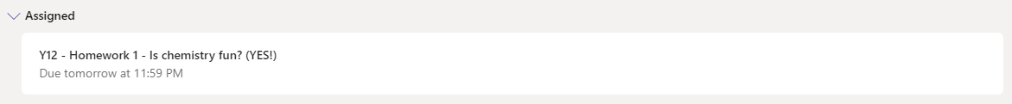
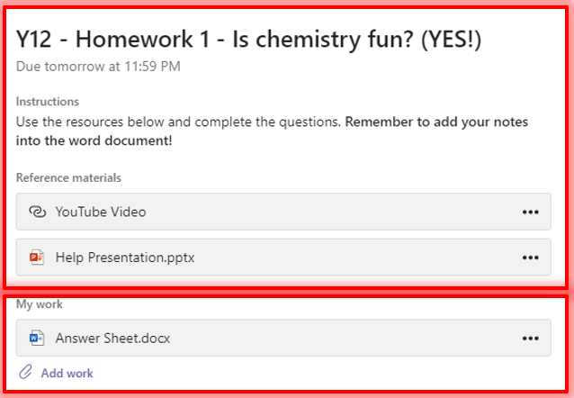
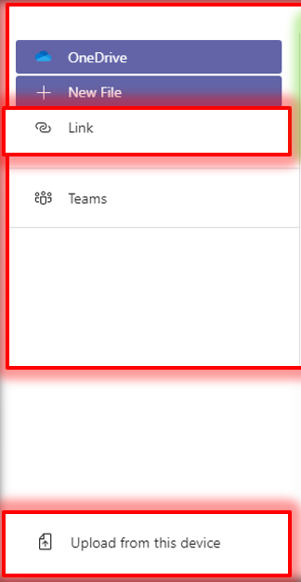
Assignments in Teams
Your teacher may set work through Teams even during normal teaching times. To access this, click ‘Assignments’ on the left hand menu.
Choose the assignment you wish to work on
There will be instructions and may be files/links to help you with the work in the ‘Reference materials’ section
There may be a sheet in the ‘My work’ section for you to work on, or you may need to upload your own work with the ‘Add work’ link.
You can add files from your OneDrive, a New File (you can add Word, PowerPoint or Excel files) or your can upload from the computer you’re working on
Make sure to ‘turn in’ your work so your teacher can send feedback
Back to Contents

Slide 13

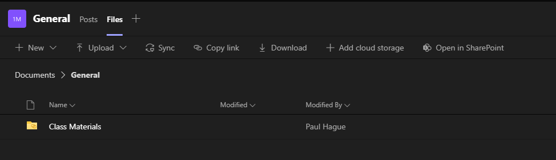
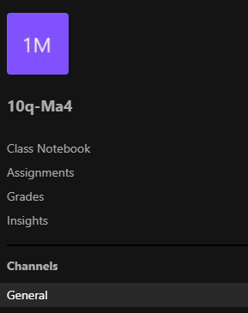
Class Files and Class Notebook.
To access Team files go to the Teams page and click on your class
There will be at least two links at the top; Posts and Files. Your teacher may put important information in the Posts section. Files you might need will be in the Files section, in the ‘Class Materials Folder.
Some teachers use ‘Class Notebook’. You can find this to the left of your Team. It acts like a big ring binder of work. Your teacher will explain how to use it, if they are using it for your class.

Slide 14
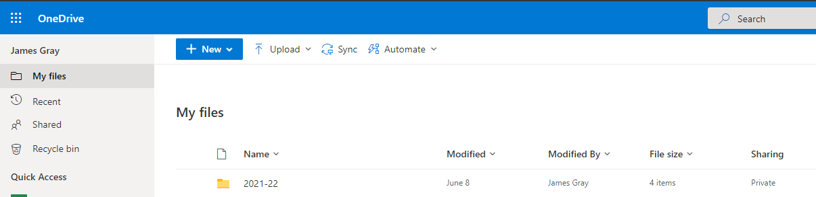
OneDrive
OneDrive is Microsoft’s cloud storage system. It allows you to save files which you can access anywhere.
To access, go to office.com (instructions here) and click OneDrive. The OneDrive icon is the little cloud.
You can start new word/powerpoint etc. files by clicking new, or you can save work from a computer by clicking upload
At the bottom of the page there is a link to download a OneDrive app so you can access them easily from a phone or computer.
Back to Contents

