Slide 1
Careers Nexus
“Choose a job you love, and you will never have to work a day in your life”

Slide 2
National Careers Week 2022 Self Awareness & Opportunities

Slide 3
Careers Guidance
Careers Education and Guidance in school is meant to help you feel confident about your future. Happy in the knowledge that when you leave school, you will have made decisions about your education and learning that will have been right for you.

Slide 4
What do I need to learn?
From the New Career Development Framework (thecdi.net)

Slide 6
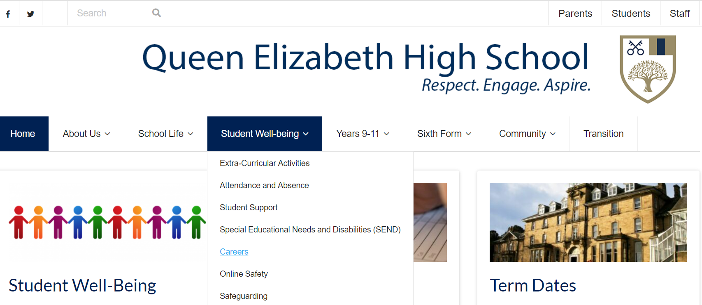

Slide 8
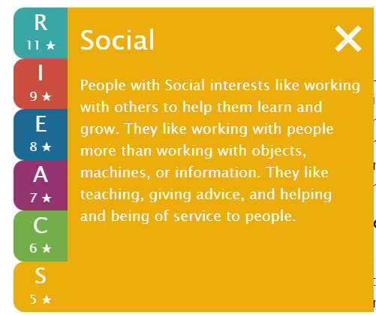
Realistic
Investigative
Enterprising
Artistic
Conventional
Social

Slide 9
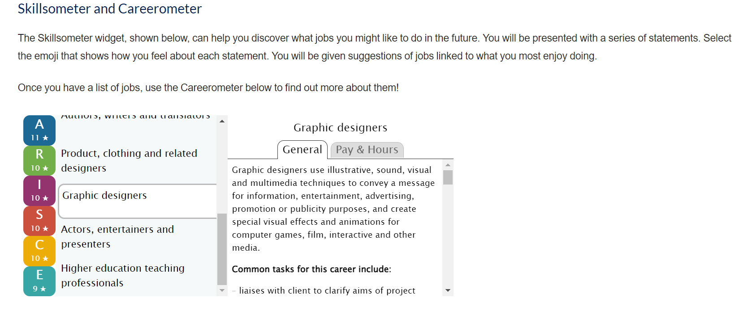

Slide 10
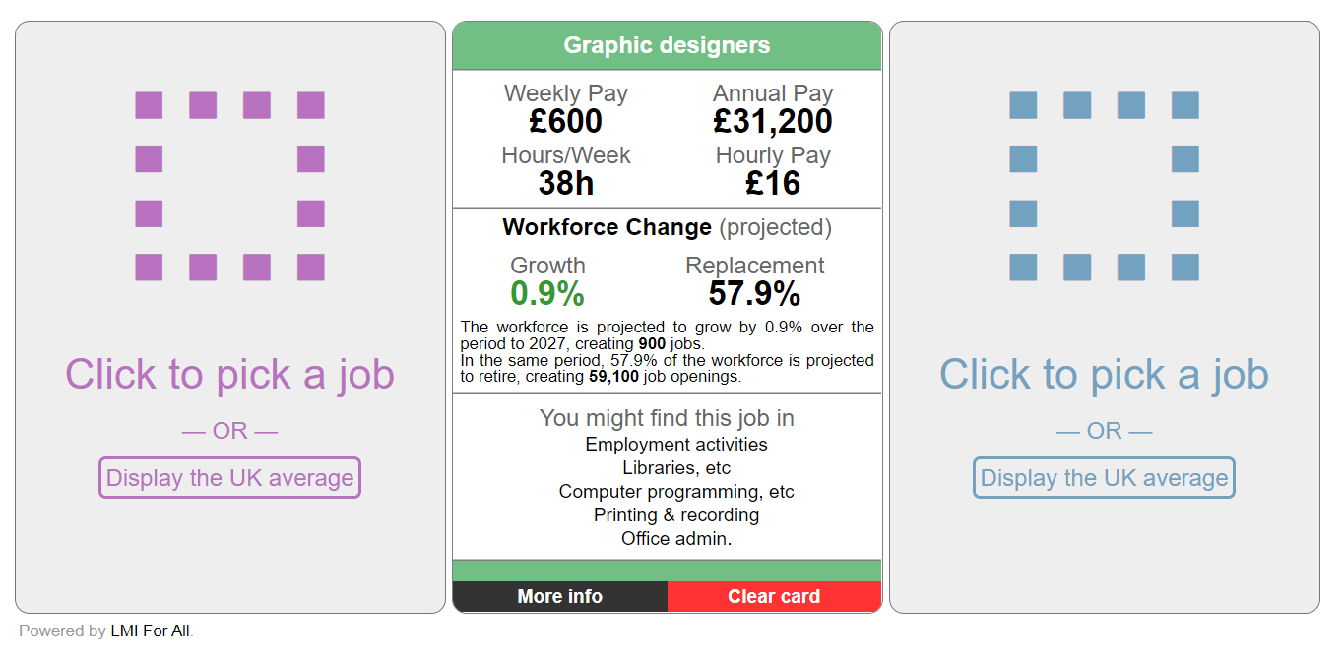

Slide 11
KS3 – What should I be doing?
Be Helpful
There are lots of opportunities in school to show people that you want to help. Your positive attitude will be remembered, and people are more likely to come to you with more ideas of what you can get involved with
Become an Entrepreneur
Raise funds for a charity that is doing work that you care about. Find ways to supplement your pocket money. Get ideas and help from adults that you trust.
Watch the news
News on the TV is more reliable than some of news sources you find online. Find out what is going on in the world around you, and talk to lots of people about it to get different views.
Notes:
Create opportunities for students to participate in the life of the school. Consider the NCW Champion program with resources for careers champions in school NCW Champions (ncw2020.co.uk)
Find a slot for watching the news in form time Home - CBBC Newsround
Helpful NCW resources: Launch Yourself; Who Are We? #NCW2020 One Stop Shop

Slide 12
KS3 – What should I be doing?
Reflect
What makes you, you? Think about what is important to you.
When you imagine the best version of you in the future, what do you see? Try a personality quiz.
Be Curious
Find out about people’s jobs and careers. Start by asking the adults you know about what they do at work and how they ended up doing the jobs that they are doing.
Get Involved
You will only find out what you are good at by trying lots of new things.
Be okay with failing, be prepared to learn from mistakes
Notes:
Personality quiz available from Buzz quiz – icould
Helpful NCW resources: Launch Yourself; Who Are We? #NCW2020 One Stop Shop

Slide 13
KS4 – What should I be doing?
Look for opportunities to gain experience
Experience of work will help you to develop skills. A part time job or volunteering is a great way to gain work experience. There are also virtual work experience schemes which school can direct you to.
Be mindful of your community
Look to help others to achieve. Your family, your friends and your school can all benefit from your time and your attention. Involve them in what you want to achieve and be involved in helping them.
Learn about the issues that shape your world
There are some organisations and companies that understand they have the power to do good work and look after their work force. Learn about how society works, globalisation, ethics and ethical behaviour.
Notes:
Online and virtual work experience is becoming increasingly accessible. Look at The Parents Guide to Careers for a full listing #NCW2020 One Stop Shop The RSA has a series of short animations about topics that will make young people think about what good work is and society RSA Animations - RSA (thersa.org)
Find a slot for watching the news in form time Home - CBBC Newsround
Helpful NCW resources: Launch Yourself; Who Are We? #NCW2020 One Stop Shop

Slide 14
KS4 – What should I be doing?
Reflect
Consider the Skills you have been developing. What are your strengths and weaknesses? What can you do to develop your skills?
Investigate Your Options
Research A Level subjects and vocational qualifications. Is Sixth Form, college or an apprenticeship right for you? Different qualifications lead to different job opportunities. Find out more at the NCW Virtual Careers Fair.
Prepare A CV
Ask for feedback. What is your CV lacking? Now is the time to think about building work experience and skills that you can talk about.
Notes:
Try the Skills Suitcase Activities #NCW2020 One Stop Shop
Explore the Virtual Careers Fair Welcome - 2022 NCW Virtual Careers Fair (ncw2022.co.uk) and use the Treasure Hunt Sheets as a guide.
For Options information check out The Parents Guide to Careers #NCW2020 One Stop Shop
CV Preparation & Advice (jobcentreguide.co.uk)

Slide 15
The 8 essential, transferable skills that we all should be experiencing and applying in school.
Seek opportunities to demonstrate these.
How can you evidence these?
Notes:
As a school we are focusing on 8 essential skills that employers are looking for in new recruits. These skills are transferable across all sectors of the working world. In lessons it is important that you try to demonstrate these skills. We want to as a school give you the opportunity to practise these before you leave us. It is about mastering them and allowing you to grow in confidence to apply these in the future

