Slide 1
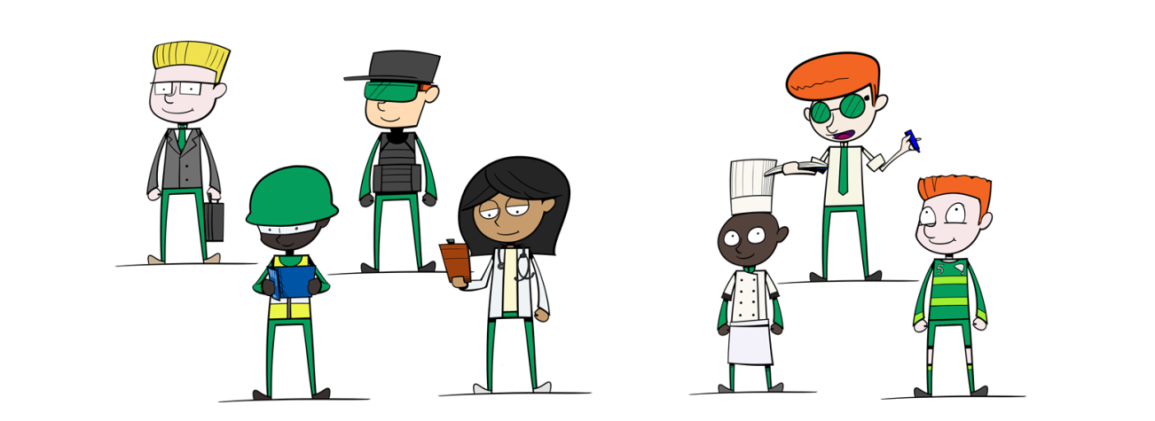

National Careers Week 2022
The Future Of Work

Slide 2
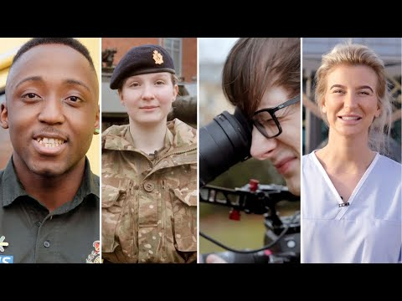

Slide 3
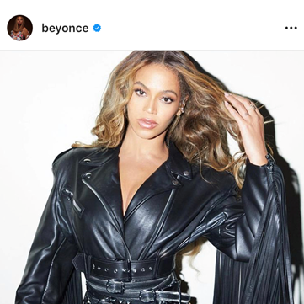
Before she was a singer, Beyonce was a…
Cleaner
Coffee Seller
Nightclub promoter
Amateur magician

Slide 4
Before she was a singer, Beyonce was a…
Cleaner
Coffee Seller
Nightclub promoter
Amateur magician

Slide 5
What is L-M-I* and why is it important?
*Labour market information.

Slide 6
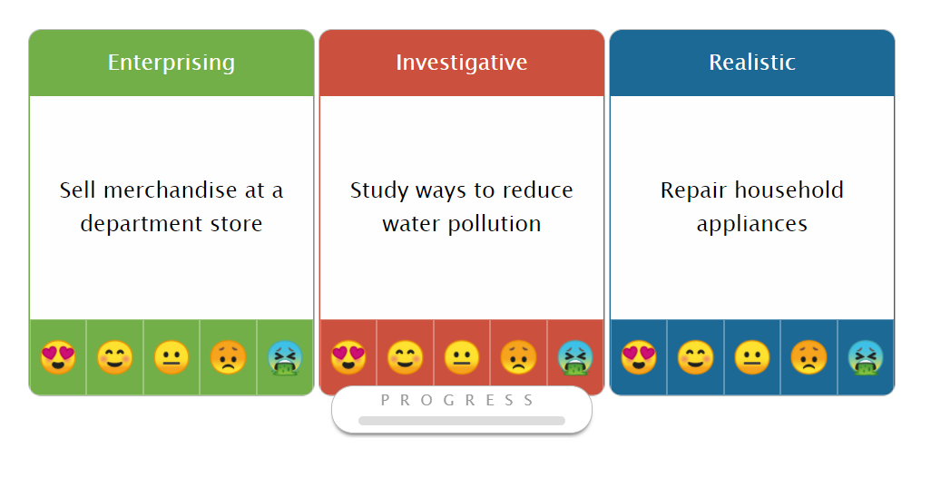
Using LMI
https://www.qehs.net/index.php/careers/

Slide 7
What is LMI?
Facts, analysis or interpretation of data gathered about working, workplaces and people. For example:
Wages
Hours worked
Working patterns
Gender balance
Qualifications needed
Geographical locations
Occupations

Slide 8
What do I need to know about that for?
Knowing certain info makes decision making easier. It answers questions such as:
Will I need to go to university?
How much will I earn
What would I do each day?
Where are most jobs in X, Y or Z located?
Which are the best Apprenticeships?
Which sectors are growing or shrinking in the UK?

Slide 9
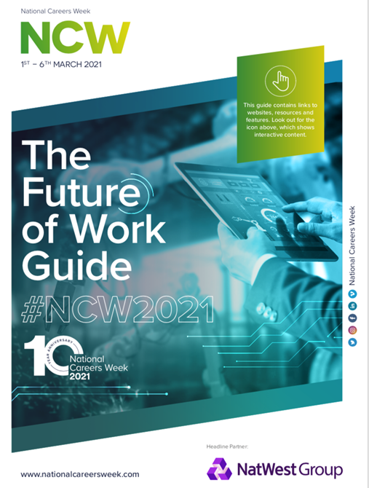
What will the future of work look like?
Let’s take a look…
Download The Guide >>

Slide 10
We are entering the Fourth Industrial Revolution…
What were the previous three?

Slide 11
The Fourth Industrial Revolution is here
The Fourth Industrial Revolution is the ongoing automation of traditional manufacturing and industrial practices using modern smart technology such as:
  AI (artificial intelligence)
  autonomous vehicles
  biotechnology
  the Internet of Things (IoT)
  nanotechnology,
quantum computing
robotics
5G wireless technology
3D printing.

Slide 12
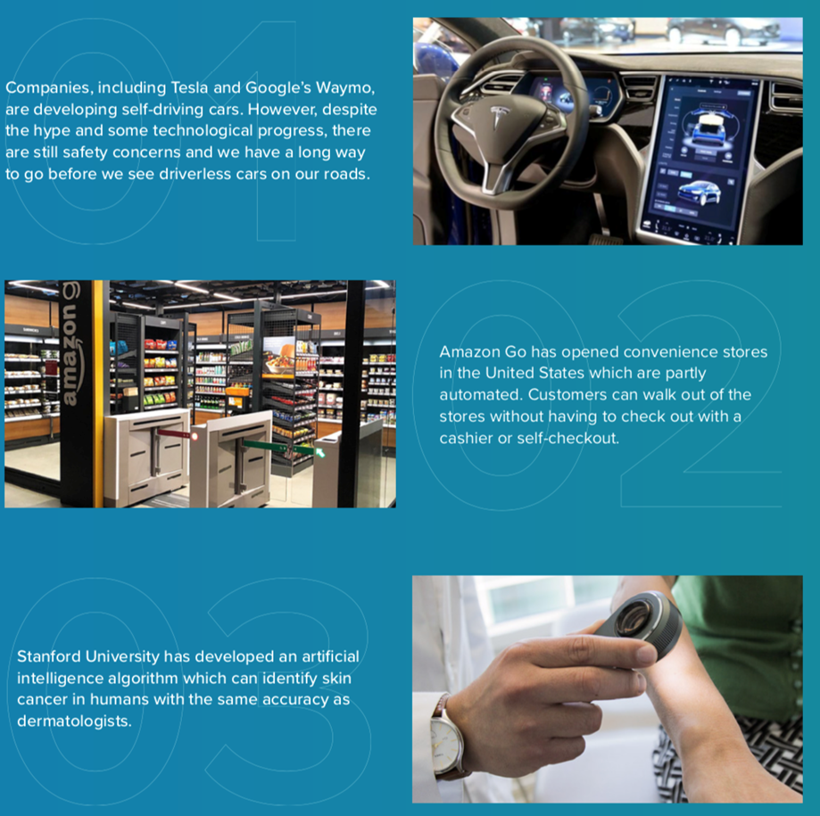
Fourth Industrial Revolution
Self-driving cars.
Self-serve shops.
AI to assist medical professionals

Slide 13
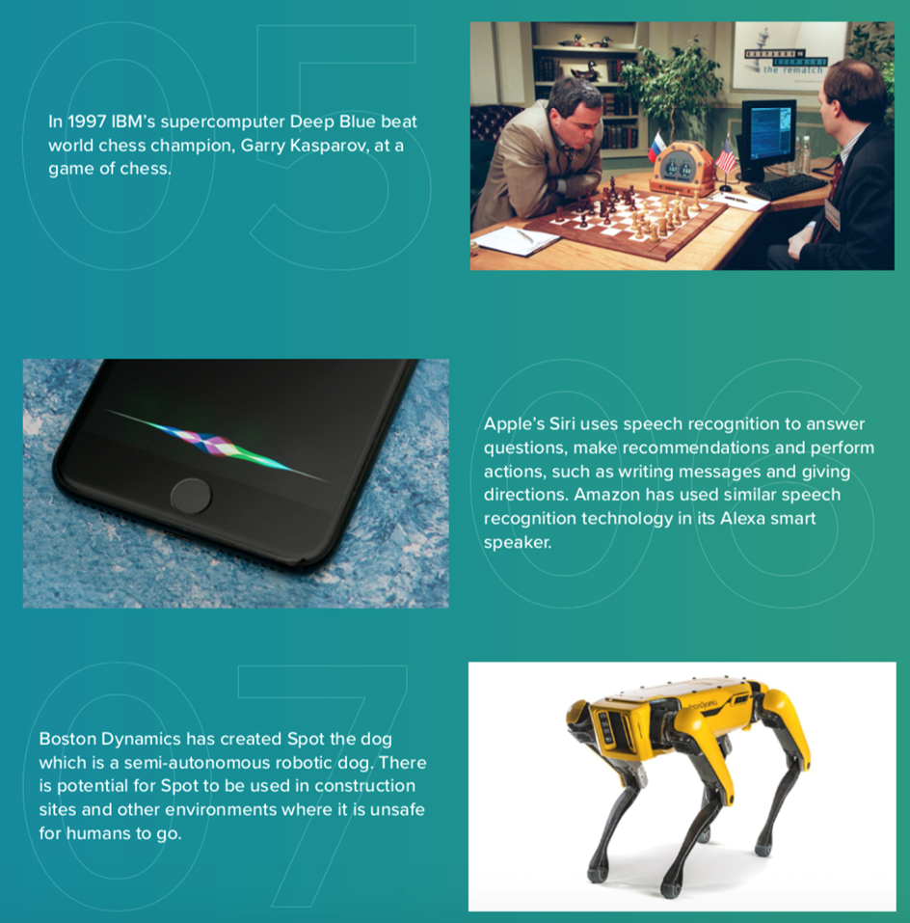
Fourth Industrial Revolution
Game theory development
AI in the home
Robotic pets & helpers

Slide 14
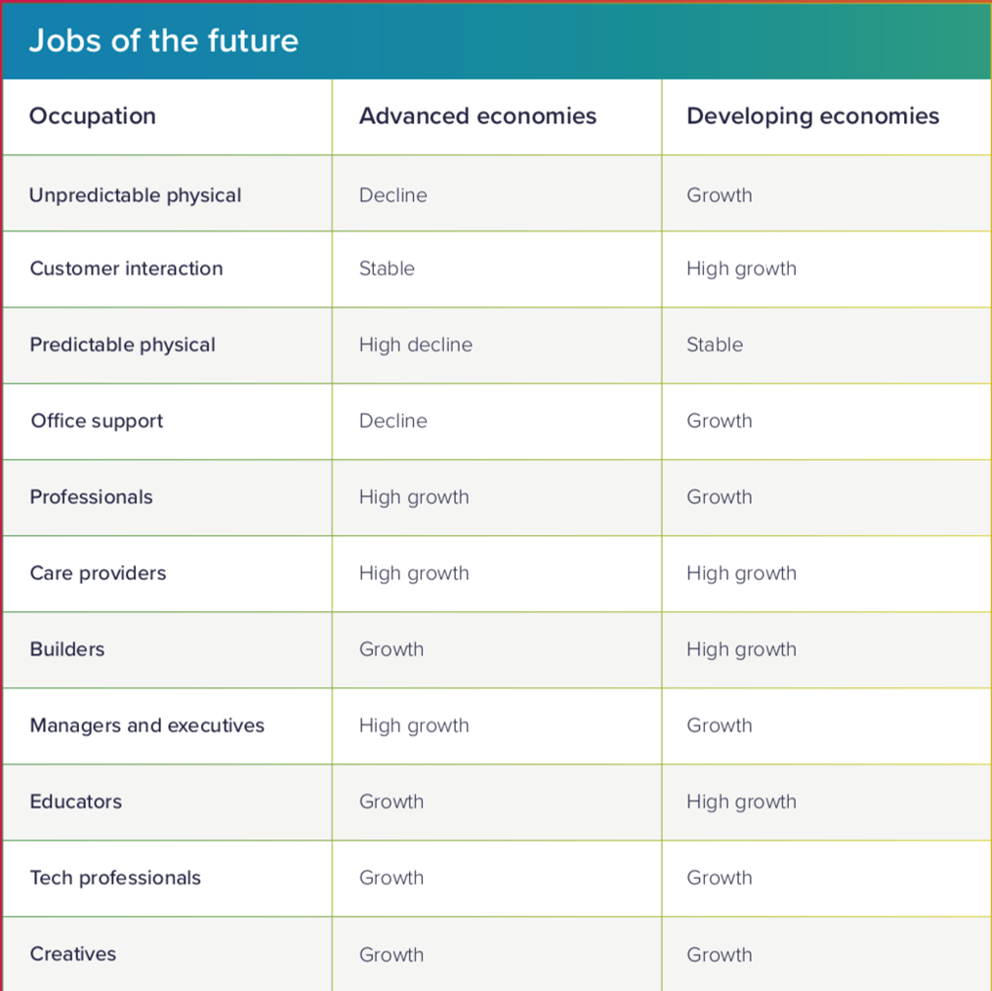
McKinsey: “Workforce transitions in a time of automation”
Technology is replacing largely manual jobs BUT technology needs to be APPLIED by professionals and creative workers in future

Slide 15
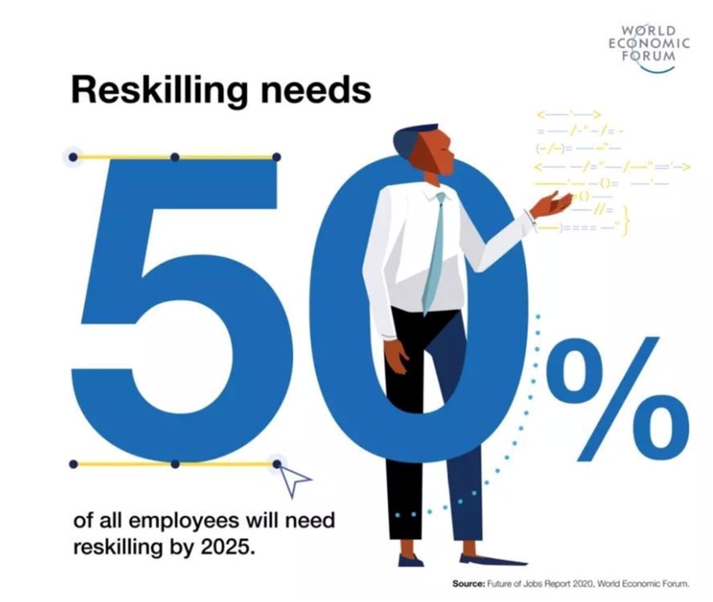
Owing to changes in technology and the fourth industrial revolution, 50% of all employees will need reskilling by 2025

Slide 16
Skills For The Future
Regardless of the roles you undertake in the future, you’re going to need these skills:
Curiosity and imagination: asking good questions
Accessing and analysing information: understanding the facts
Agility and Adaptability: being able to change constantly
Initiative and Entrepreneurship: being creative and business-minded
Collaboration and Leading with Influence: teamwork and leadership
Good Oral and Written Communication: being understood
Critical Thinking and Problem Solving: being able to see solutions

Slide 17



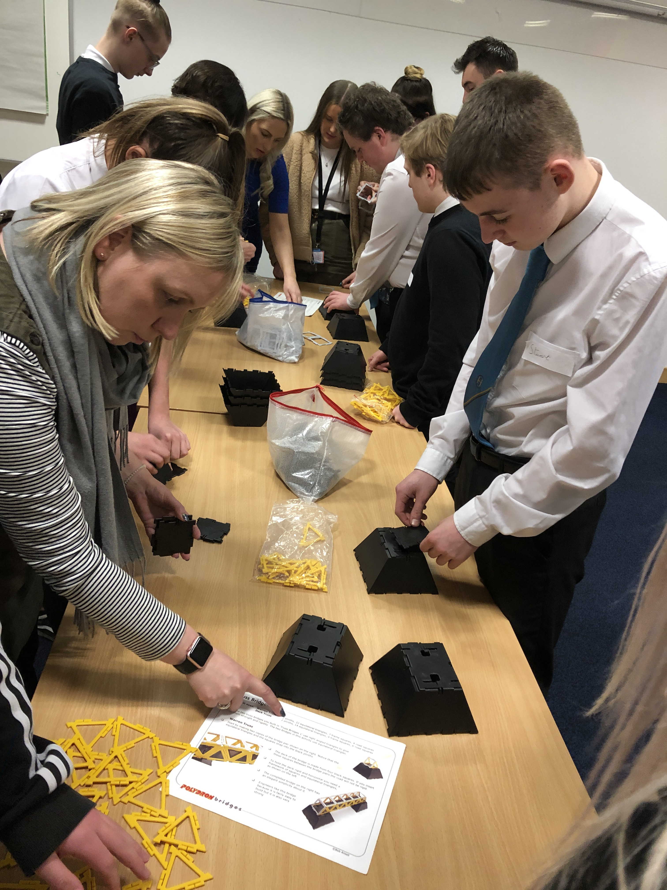


Typical skills for future roles
Coding and the ability to understand and apply technology.
Building a network of partners and skills.
Self-directed Learning.
Language skills to work globally.
Being able to work in a team and lead.
Being able to predict and adapt to changes in working in all areas.

Slide 18
If you want to…
stay & work near your home
have a good grasp of pay in your area and career choices
find jobs where posts have secure, long-term contracts;
You need LMI!
YOUR future is in YOUR hands – LMI can help you decide on your future career.

Slide 19


Slide 20
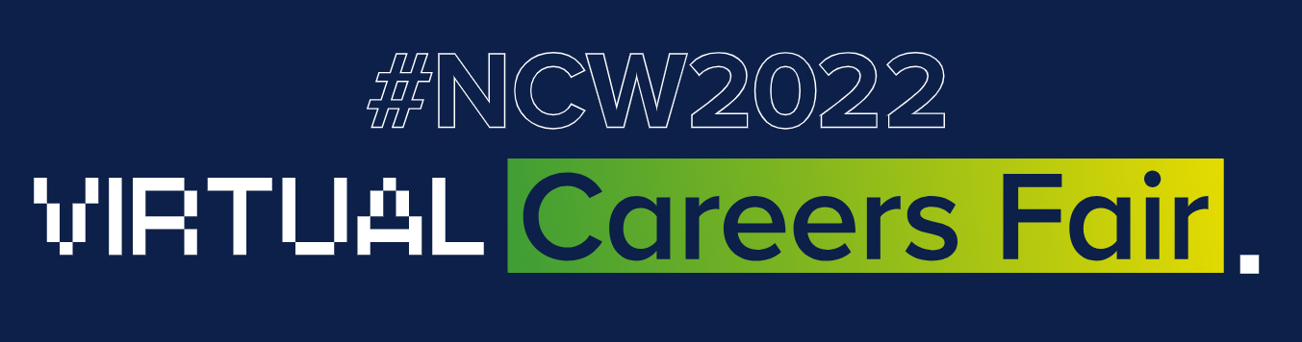
https://ncw2022.co.uk/

Slide 21



Further Information
Free National and Regional service
https://NationalCareers.Service.gov.uk
Explore careers through stories.
https://icould.com
https://NCWTV.co.uk
Free video resources in dozens of industries.

