Slide 1
Y9 Curriculum
Thursday 26th march

Slide 2
Achievement & Progression Support
Mrs Fletcher-Woods
(Assistant Headteacher)
Mrs Ruddick (Advisor)
Ms Van Den Berg (Advisor)
curriculum@qehs.net

Slide 3
Structure of the Day
8.45 – tutor time for 30 mins
9.15 – P1
10.15 – P2
11.15 – break
11.30 – P3
12.30 – Lunch
13.20 – P4
14.20 – P5
15.20 – End of school
Notes:
2 week timetable

Slide 4
Broad and balanced
Students will study a full curriculum in Y9.
Broad and balanced to enrich their experience of Yr 9.
Notes:
Full curriculum – follows the national curriculum as set out by the DfE. Choice of French or Spanish. Roll over timetable in May.

Slide 5
Yr 9 Subjects
Maths (7)
English (8)
Biology (2)
Chemistry (2)
Physics (2)
Geography (3)
History (3)
PE (4)
RE & PSHE (3)
IT (2)
Drama (2)
Technology (2)
Art (2)
Music (2)
French/Spanish (6)
Notes:
Numbers in brackets is equal to the number of hours taught per fortnight. English will cover literature and language.

Slide 6
Key Stage 4 2023/24
Broad and balanced curriculum
9 courses at GCSE or equivalent
Students will continue with French/Spanish (unless directed otherwise)
Choice of history or geography (Humanities)
Science (Combined/Triple)
1 or 2 further subjects depending on science choice

Slide 7
Modern Foreign Languages
Global citizens prepared for the wider world
Majority of students will study either French or Spanish at GCSE
Students in current Y7 are studying 2 languages
Your children will choose French or Spanish to study in Y9 and will study this to the end of GCSE
Spanish taster sessions will take place and you will complete an options form
Why French and Spanish only?
Good outcomes
Accesible
Most popular at QEHS
Good progression
Notes:
Latin will be available as an extra curricular activity in Yr 9 and as a GCSE subject for Yr 10/11. German will not be available.

Slide 8
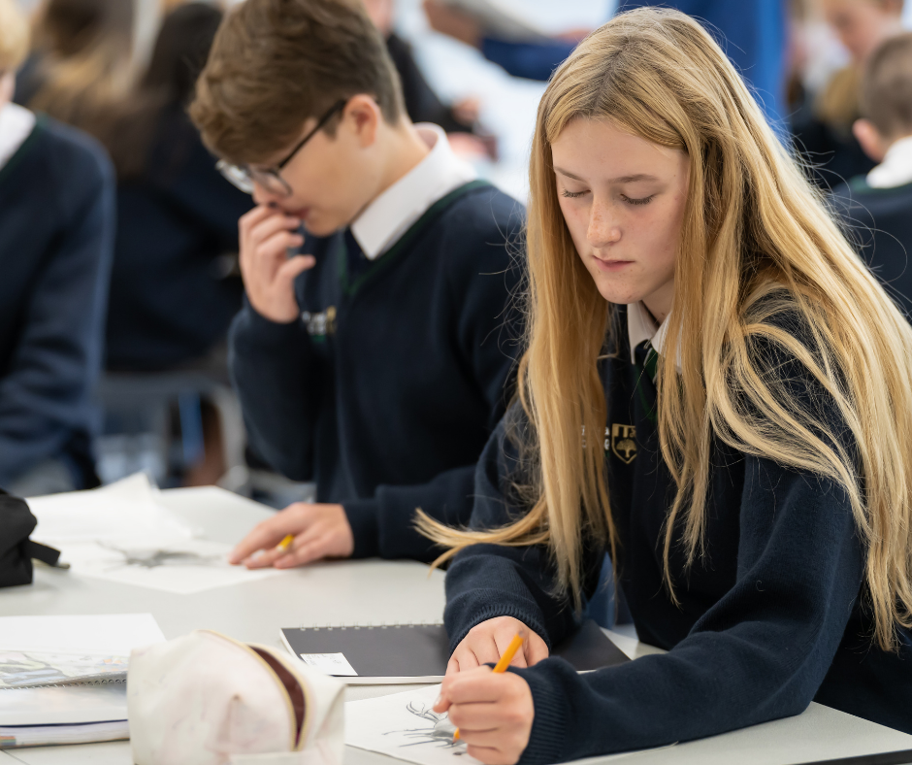
What’s next?
Submission of MfL options choice – by the end of June (form sent by e-mail)
Information sharing from middle schools - ongoing
Transfer day – 12th July
Parent Information Evening on Student Support – meet the student support team – 13th July
Welcome to Y9 day – Tuesday 6th September
Notes:
Key messages

