Slide 1



Slide 2


Intermediate – degree level
Employed
Off the job
Paid a salary
Typically 1-6 years
Real responsibilities
600+ standards
Contract
Not the easy option

Slide 3

Name | Level | Equivalent educational level
Intermediate | 2 | 5 GCSE passes at grade A*-C or 4-9
Advanced | 3 | 2 A Levels / Level 3 diploma / international Baccalaureate
Higher | 4,5,6 & 7 | Foundation degree and above
Degree | 6 & 7 | Bachelor’s or master’s degree

Slide 4

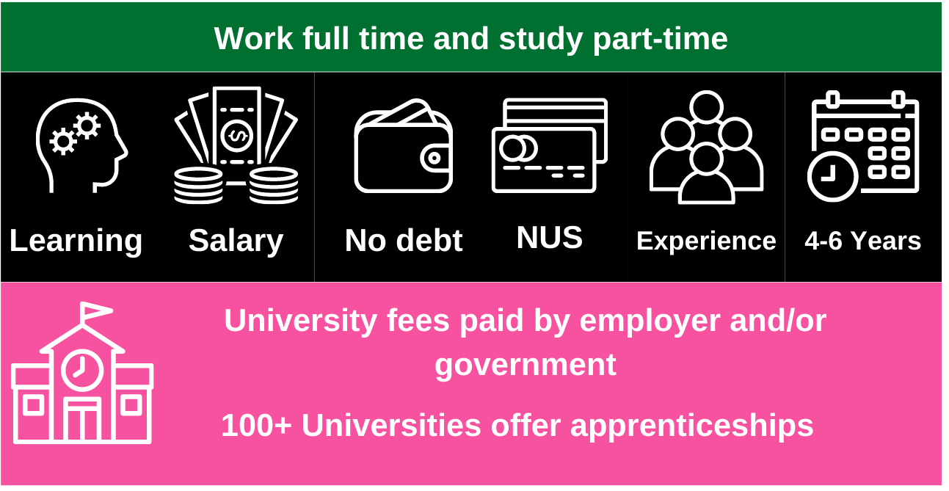

Slide 5







Sport
Beauty
Law
Business
Beauty
Media & Art
Sport
Audit
Manager
HR
Coaching
Safety
Trainer
Hairdressing
Barbering
Therapist
Graphic
Fashion
Interior
Health
Media & Art
Law
Health
Paralegal
Solicitor
Prosecution operations
Nurse
Dental Technician
Veterinary Nurse

Slide 6

Job opportunity | Closing date | Level | Salary
Dental Nurse, Corbridge Dental Practice | 28th Dec | 3 – Advanced | £144.30 pm
Early Year Practitioner, Meadows Children’s Nursery | 16th Dec | 3 – Advanced | £180.38 - £356.25 pm
Business Admin – Wise Academies | 9th Dec | 3 – Advanced | £9,379 pa
Assistant Buyer, Cogent Skills Ltd | 27th Nov | 4 – Higher | £15,000 pa
Audit Assistant, Armstrong Watson LLP | 1st Dec | 7 – Masters Degree | £20,000 pa
Notes:
This slide shows a range of vacancies that I could find.
You will notice that they all have different closing dates – this is one big difference to applying for university.
If you do see a closing date, it’s important that you don’t wait until the very end to submit your application. We are now finding from talking to employers, if they receive a huge number of applications, they may decide to close the application window early.
You will also notice the range of different salaries too – this is because employers can decide what to pay (as long as it meets the national minimum wage for apprentices of £4.81)
Presenter notes: It might be useful to have the find an apprenticeship website open to show them current examples and what the site looks like. This is also relevant for the next slide.

Slide 7

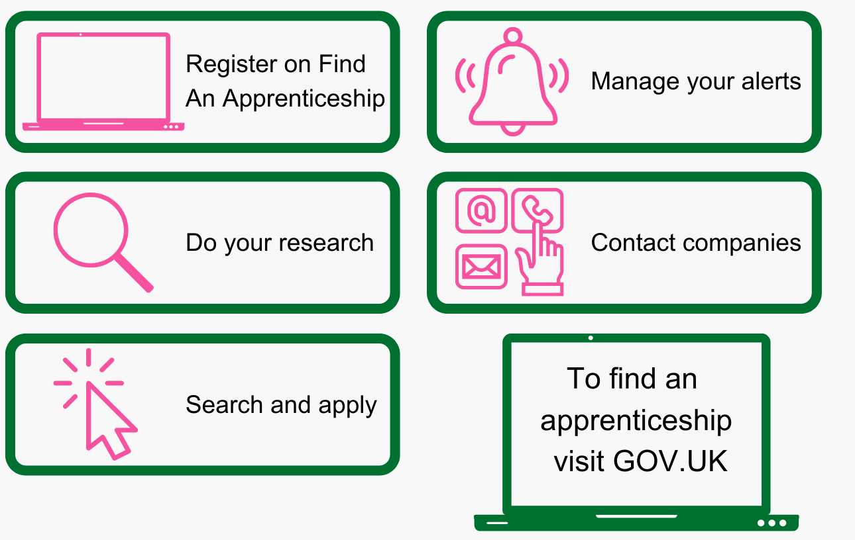

Slide 8

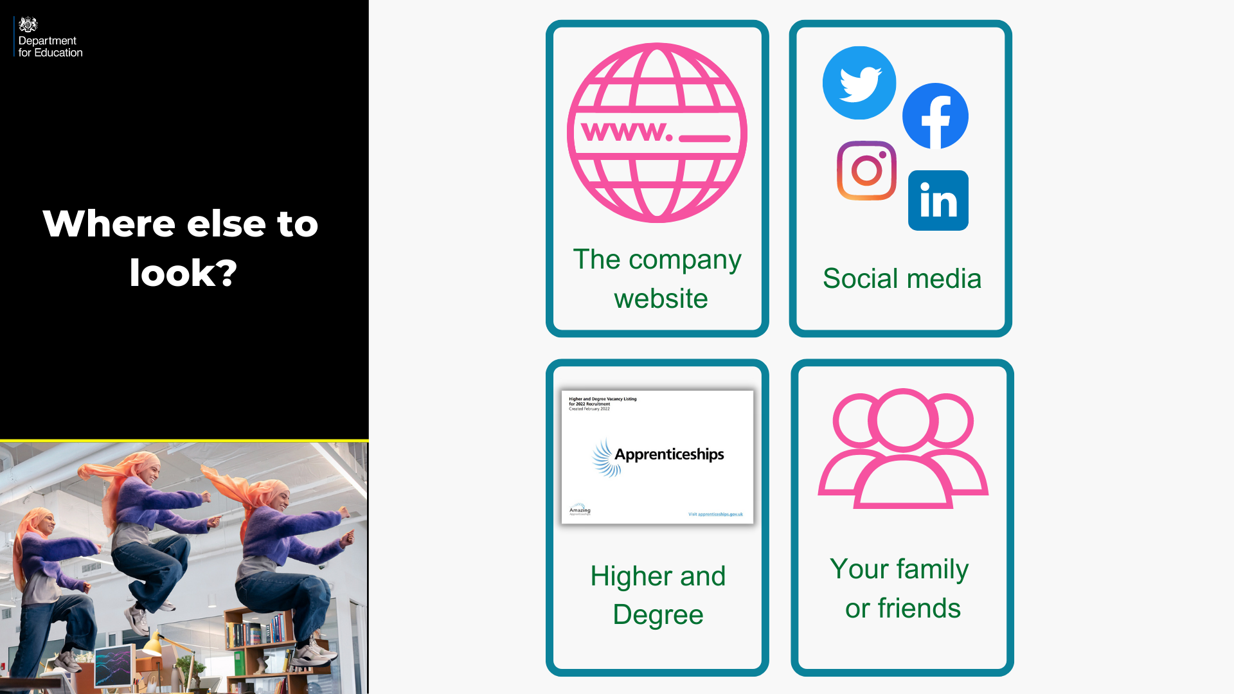

Slide 9

Wage
Progression
Job position
Training providers
Ethos and values
Varied role

Slide 10
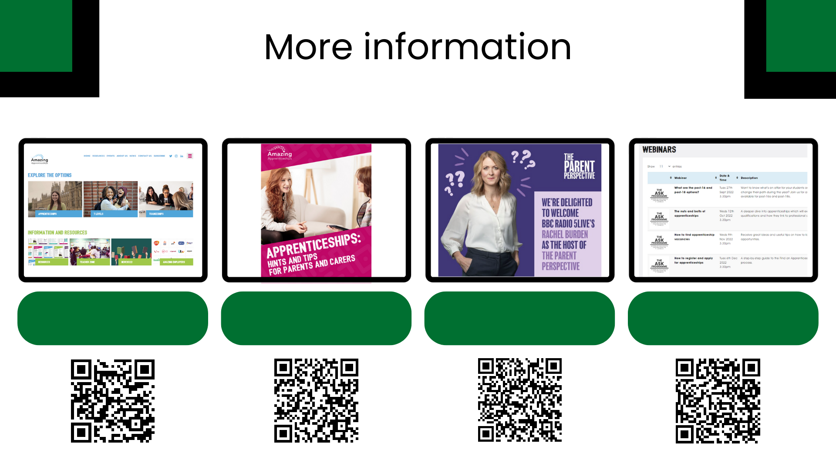
Amazing Apprenticeships website
Guide to apprenticeships: Parents
Parent Perspective Podcast
Workshops and webinars

