Slide 1
Joints, movements and muscles

Slide 2
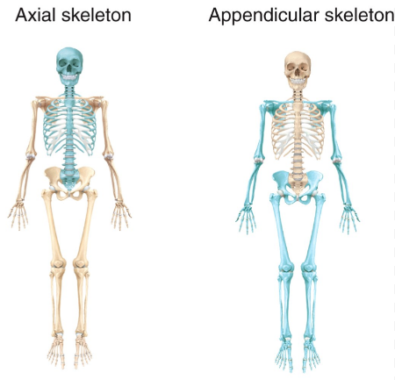
Label the following bones
Sternum
Rib cage
Vertebral column
Pelvic girdle
Scapula
Humerus
Ulna
Radius
Carpals
Femur
Tibia
Fibula
Talus

Slide 3
Types of joint
Fill in the following table
Class of Joint | Mobility | Stability | Examples from the skeleton
Fibrous | No Movement | Most Stable | Joint between the bones of the skull and between the fused bones of the sacrum and coccyx.
Cartilaginous
Synovial

Slide 4
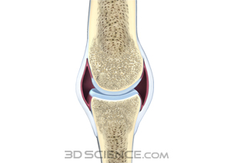
Structure of synovial joint
Label the synovial joint
Ligament
Synovial fluid
Articular cartilage
Joint capsule
Bursa

Slide 5
Structure of a synovial joint
Feature | Structure | Function
Ligament
Synovial Fluid
Articular Cartilage
Joint Capsule
Bursa
Complete the table

Slide 6
Types of synovial joint
Complete the following table:
Type of joint | Examples | Description | Mobility (movement)
Ball and socket
Hinge
Condyloid
Pivot
Gliding

Slide 7
Types of movement
Complete the following table and find some pictures to help you see each movement visually
Name | Type of movement
Flexion | Of a joint makes part of the body move in a forwards direction from the anatomical position
Extension
Horizontal flexion
Horizontal extension
Abduction
Adduction
Medial rotation
Lateral rotation
Circumduction
Plantar flexion
Dorsi-flexion

Slide 8
Movements of major joints
Learn this table!
Joint | Joint Type | Movements Possible
Wrist | Condyloid | Flexion & Extension Abduction & Adduction
Shoulder | Ball and Socket | Flexion & Extension Horizontal Flexion & Horizontal Extension Abduction & Adduction Medial & Lateral Rotation Circumduction
Hip | Ball and Socket | Flexion & Extension Abduction & Adduction Medial & Lateral Rotation
Elbow | Hinge | Flexion & Extension
Knee | Hinge | Flexion & Extension
Ankle | Hinge | Dorsiflexion & Plantarflexion

Slide 9
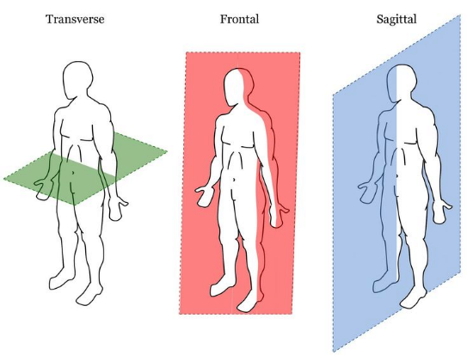
Planes of motion
Describe each plane – where do they run from – to?

Slide 10
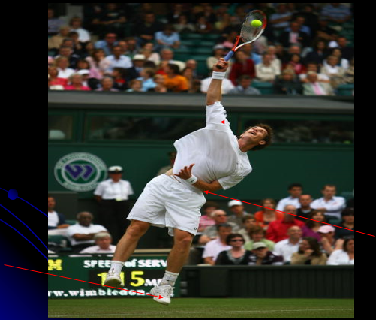
task
Can you identify the names of the highlighted joints e.g. elbow the type of joint it is e.g. hinge, the type of movement that is shown in the picture e.g. flexion and the plane through which the movement is occurring e.g. sagittal.

Slide 11
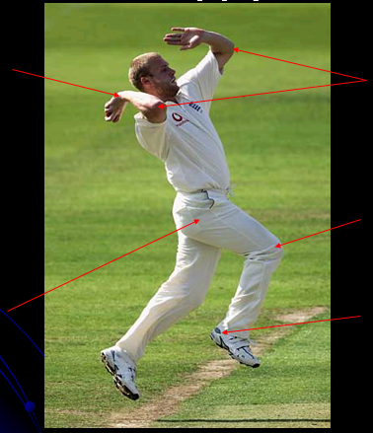
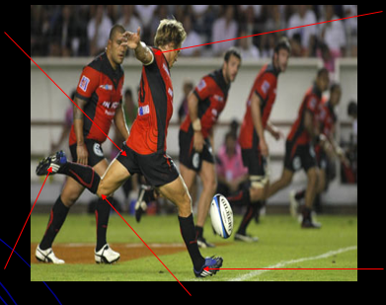
Task

Slide 12
Articulating bones
Fill in the following table
Joint name | Bones that articulate
Wrist
Elbow
Shoulder
Hip
Knee
Ankle

Slide 13
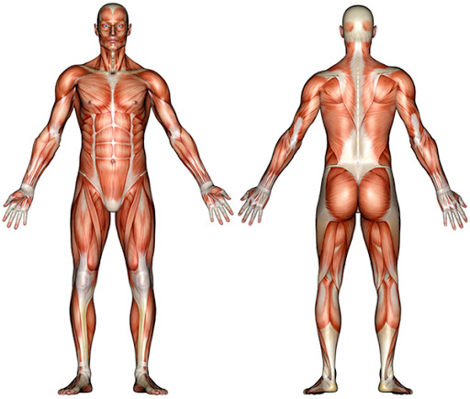
Muscular system
Label and learn the following muscles
Pectoralis major
Biceps brachii
External obliques
Wrist flexors
Tabialis anterior
Rectus femoris
Adductor longus
Rectus abdominus
Anterior deltoid
Trapezius
Teres major
Wrist extensors
Soleus
Gastrocnemius
Bicep femoris
Gluteus maximus
Latissimus dorsi
Triceps brachii
Posterior deltoid

Slide 14
The role of muscular contraction
Research the terms
Isotonic contraction
Concentric contraction
Eccentric contraction
Isometric contraction

Slide 15
The motor unit and skeletal muscle contraction
KEY TERMS
Motor Neuron – a nerve cell which conducts a nerve impulse to a group of muscle fibres
Motor Unit – a motor neuron and the muscle fibres stimulated by its axon
Action Potential – positive electrical charge inside the nerve and muscle cells
which conducts the nerve impulse down the neuron and into the muscle fibre.
Neurotransmitter- a chemical produced and secreted by the neuron which transmits the nerve impulse across the synaptic cleft to the muscle fibre.
All-or-none law – depending on whether the stimulus is above a threshold, all muscle fibres will give a complete contraction or no contraction at all.

Slide 16
The motor unit and skeletal muscle contraction
Summarise how a motor unit is stimulated so muscular contraction occurs
Nerve impulse initiated in the motor neuron cell body
Nerve impulse conducted down the axon of the motor neuron by a nerve action potential to the synoptic cleft.
Neurotransmitter called acetylcholine is secreted into the synoptic cleft to conduct the nerve impulse across the gap.
If the electrical charge is above a threshold, the muscle fibre will contract.
This happens in an all-or-none fashion

Slide 17
Muscle fibre types
Research the structure and function of each muscle fibre type.
Extension: can you apply these to sporting examples?
Slow oxidative
Fast oxidative glycolytic
Fast glycolytic

