Slide 1
Cardiovascular system

Slide 2
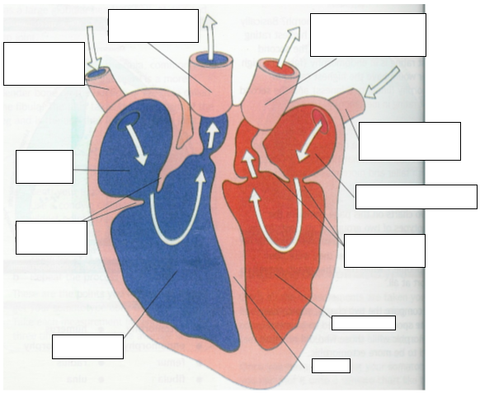
Label the structure of the heart

Slide 3
The cardiovascular system at rest

Slide 4
Stroke volume, cardiac output and heart rate
Define stroke volume, cardiac output and heart rate
Research the average stroke volume, cardiac output and heart rate

Slide 5
Trained v untrained
Research why an trained performer may have a lower heart rate, higher stroke volume, but the same cardiac output as an untrained performer?
 | HR | SV | Q
Untrained | 70-72 bpm | 70ml | 5 l/min
Trained | 50 bpm | 100ml | 5 l/min

Slide 6
The cardiac cycle
Make notes on the cardiac cycle, including the diastole and systole phase.
The cardiac cycle represents the mechanical events of one heartbeat. At rest, one complete cycle lasts 0.8 seconds and is repeated approximately 72 times a minute. The cardiac cycle consists of two phases that represents the contraction and relaxation of the heart muscle.
Diastole – lasting 0.5 seconds, represents the relaxation phase.
Systole – lasting 0.3 seconds, represents the contraction phase.

Slide 7
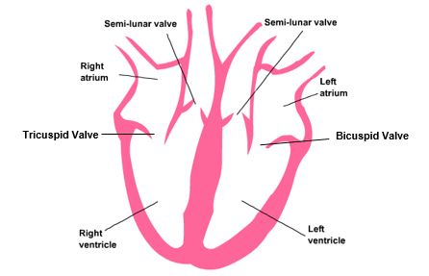
Diastole (0.5 seconds)
Both atria fill with blood. AV valves closed.
Atrial blood pressure rises above ventricular pressure.
Rising blood pressure forces AV valves open and blood passively passes into both ventricles. Semilunar valves closed.

Slide 8
Systole (0.3 seconds)
4. Both atria contract, actively forcing the remaining atrial blood into ventricles.
5. Semilunar valves remain closed.
6. Both ventricles contract increasing ventricular pressure.
7. Semilunar valves forced open. AV valves closed.
8. Blood forced out into: aorta to body tissues/muscles = stroke volume; pulmonary arteries to lungs. Please be aware that only 40/50% blood is ejected at rest during ventricular systole (SV)
9. Diastole of the next cardiac cycle begins. Semilunar valves close presenting backflow of blood from aorta and pulmonary arteries.
Note – 4 and 5 = Atrial Systole
Note - 6,7 and 8 = Ventricular Systole

Slide 9
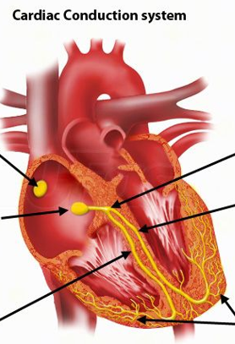
Hearts conduction system linked to cardiac cycle
The electrical impulse responsible for stimulating the heart to contract is called the cardiac impulse.
Label the cardiac conduction system

Slide 10
The cardiac conduction system
Watch the following video clip and use the following information to write notes on the cardiac system
https://www.youtube.com/watch?v=bxKBQqe_Bo0
The Cardiac impulse is initiated from the Sinoatrial Node (SA) (1) located in the posterior wall of the right atrium and is often termed the pace maker.
The impulse travels through the left and right atrial walls (2) causing both atria to contract
The ventricles are insulated from the atria and cannot be stimulated at this point.
The cardiac impulse reaches and activates the AV (3) (Atrio Ventricular) which passes the impulse down into the Bundle of His (4).
The AV node actually helps delay the impulse allowing the contraction of the atria to finish before the ventricles begin to contract.
The Bundle of His splits into the left and right branches (5) and spreads the impulse down to the bottom of the heart and then up and around the walls of both the ventricle walls via a network of Purkinje Fibres (6), causing both ventricles to contract
The ventricles relax and the cycle is repeated with the next cardiac impulse initiated from the SA node.

Slide 11
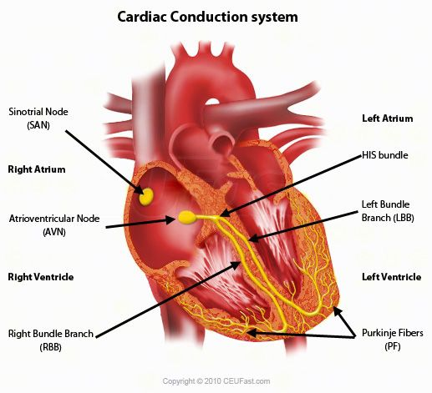
The cardiac and conduction system
Describe how the CONDUCTION SYSTEM of the heart controls the CARDIAC cycle.
(HINT: You need to join both of these concepts together to help you explain this)

Slide 12
Cardiovascular system during exercise

Slide 13
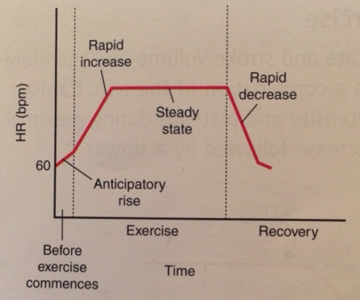
Heart rate response to aerobic exercise (sub maximal)
Label the graph with the following
1. Resting Heart Rate – average is 72bpm
- trained athlete 6obpm (Bradycardia / Hypertrophy)
2. Anticipatory Rise
HR increases before exercise due to release of adrenalin which acts on SA node to increase HR and SV
3. Rapid Increase in HR
Receptors stimulate the Cardiac Control Centre which stimulates the SA node to increase HR
4. Continued but Slower Increase in HR
5. Slight fall / steady state plateau in Heart Rate (Aerobic sub maximal 130 – 150 bpm)
Oxygen supply equal to the demand of muscles
6. Rapid fall in Heart Rate
As exercise stops

Slide 14
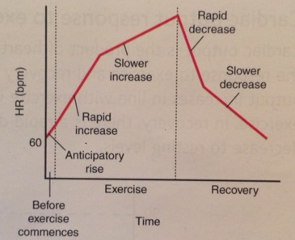
Heart rate response to anaerobic exercise (maximal)
Label the graph with the following information
1. Resting Heart Rate – average is 72bpm
- trained athlete 6obpm (Bradycardia / Hypertrophy)
2. Anticipatory Rise
HR increases before exercise due to release of adrenalin which acts on SA node to increase HR and SV
3. Rapid Increase in HR
Receptors stimulate the Cardiac Control Centre which stimulates the SA node to increase HR
4. Continued rise in Heart Rate (Anaerobic / Maximal exercise)
Heart rate will continue to rise towards maximal values Anaerobic work where the supply of oxygen is below the demand from the muscles
Continued anaerobic increases lactic acid build up leading to muscle fatigue
5. Rapid fall in Heart Rate
As exercise stops
6. Slower fall in Heart Rate then after for Anaerobic Exercise
Heart Rate remains elevated above resting values to help repay Oxygen Debt and to remove lactic acid

Slide 15
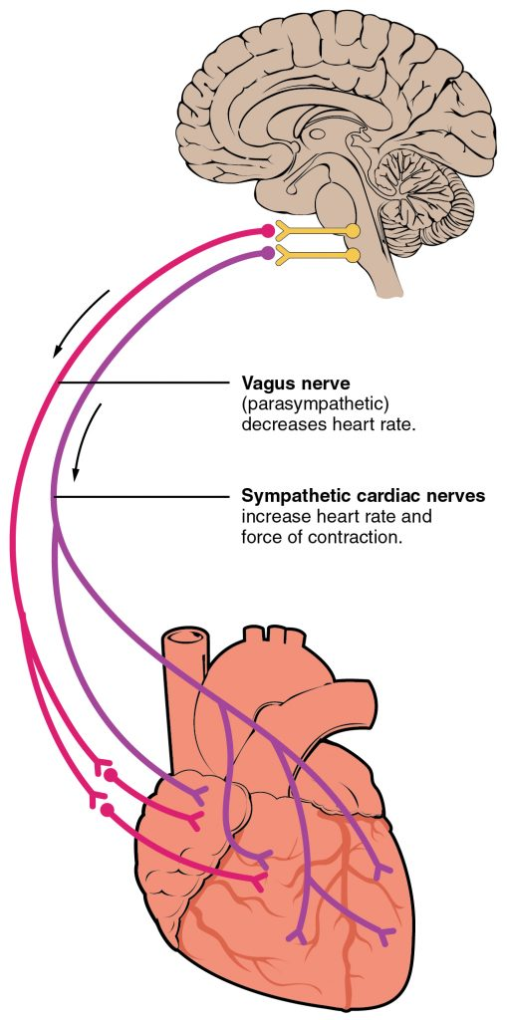
Cardiac control
Research the cardiac control centre including:
Where is it located in the brain?
What does it initiate?
What do sympathetic and parasympathetic nerves do?

Slide 16
Neural, Hormonal and Intrinsic Factors Affecting the Cardiac control centre
Research the following receptors that affect the cardiac control centre. Include:
Where they are located
What their roles are
Baroreceptors
Chemoreceptors
Proprioceptors
Temperature
Venous return
Adrenaline

Slide 17
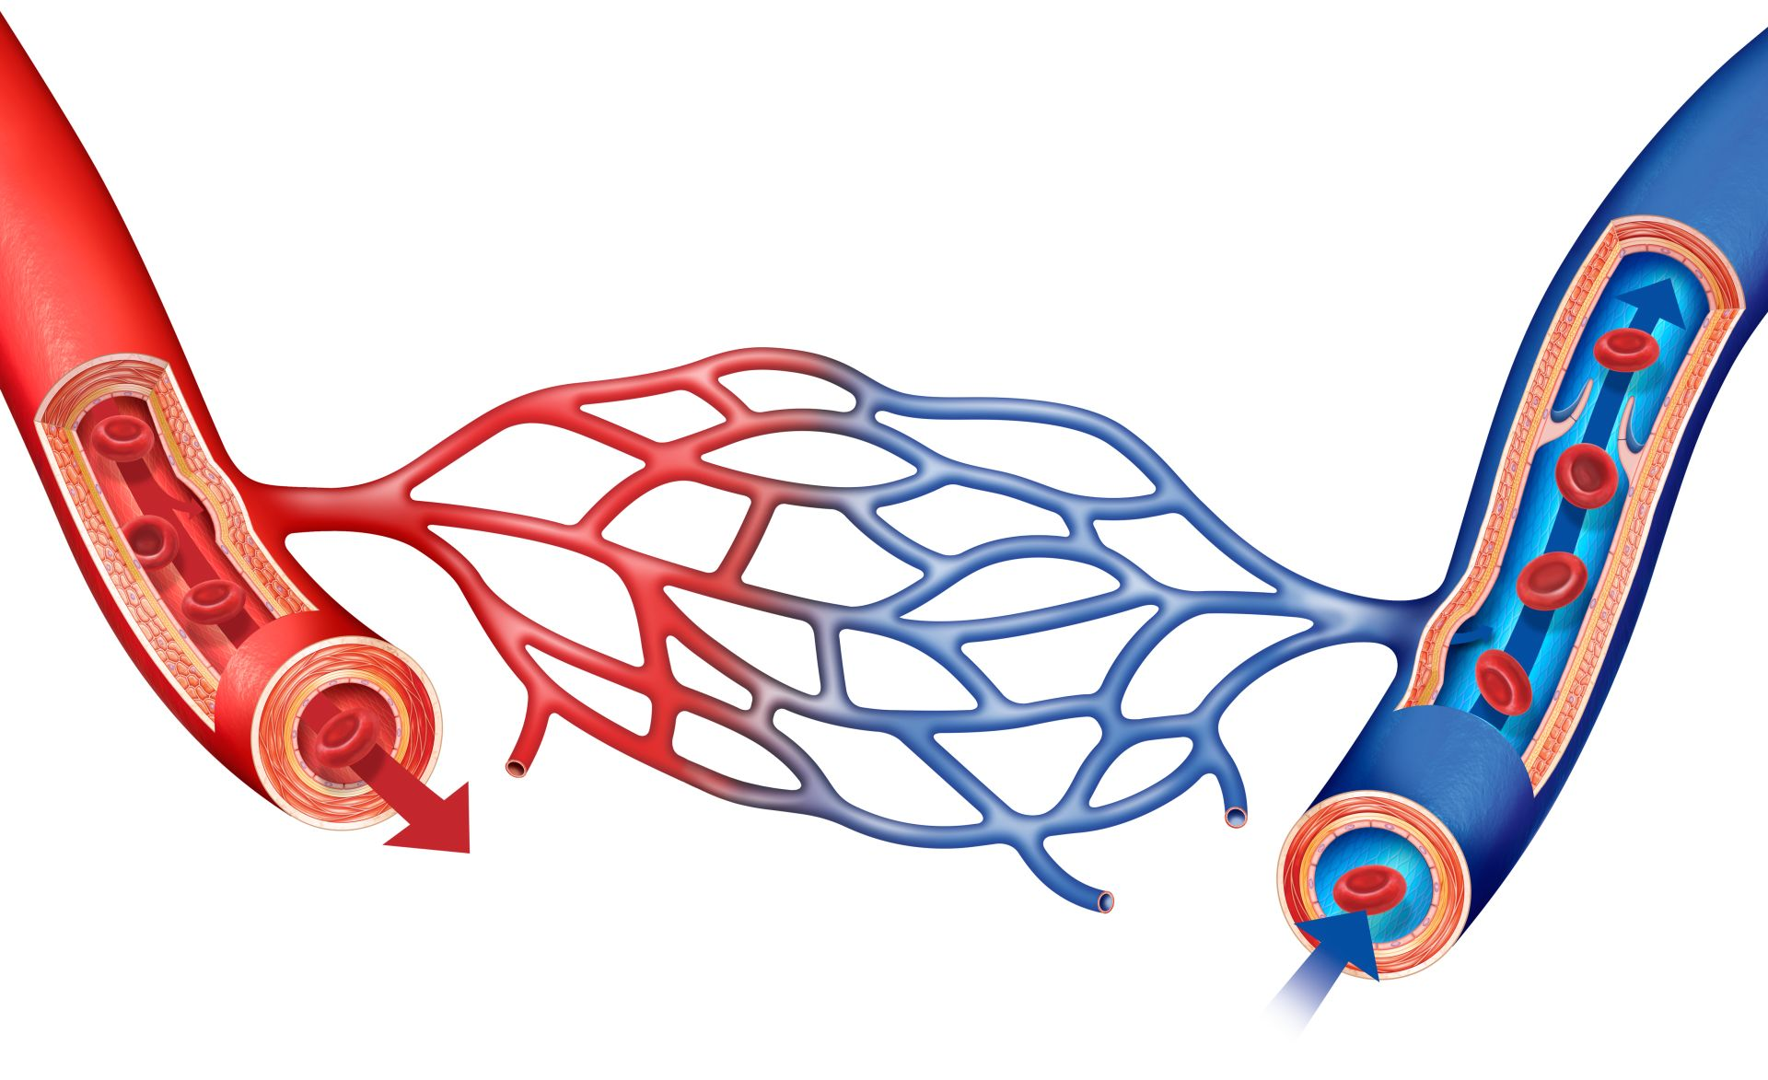
Blood vessels
Research the structure and function of the following blood vessels:
Arteries
Veins
Capillaries

Slide 18
task
Research the terms venous return and Starling’s Law

Slide 19
Maintenance of venous return (Vr mechanisms)
Write notes on the following key terms:
Pocket Valves – one way valves in the veins prevent backflow of blood and direct it towards the heart.
Muscle Pump – veins are situated between skeletal muscles, which when contracting and relaxing, help to push or squeeze blood back towards the heart.
Respiratory Pump – during exercise, breathing becomes deeper and faster which causes pressure changes in the thorax and abdomen.
This increases the pressure in the abdomen, squeezing the large veins in that area and helping force the blood back to the heart.
Smooth Muscle – contraction and relaxation of smooth muscle in the middle layer of the vein walls also helps to push blood through the veins and towards the heart.
Gravity – blood from the upper body is aided by gravity as it descends to the heart.

Slide 20
Venous return – how it works
Make notes on the following:
(Blood pooling is often described as a feeling of heavy legs.)
VR requires force to push the blood back towards the heart. If there is insufficient pressure the blood will sit in the pocket valves of the veins.
Increased Q sent to the muscles in the legs actually pools or sits here with insufficient pressure to return to the heart.
Pocket valves, gravity and smooth muscle are quite sufficient to maintain VR during rest but not during or immediately after exercise.
The additional mechanisms of the skeletal and respiratory pump are needed to ensure VR is maintained.
An active cool down helps to maintain these two important mechanisms.
An elevated respiration rate maintains the respiratory pump and continued skeletal muscle contractions maintain the effect of the skeletal muscle pump.
All these mechanisms help maintain VR and redistribute Q to prevent blood pooling.

Slide 21
Relationship between vr and performance
Increased blood flow back to the right atrium of the heart (Venous Return)
The right atrium stretches, which causes the SA node to increase rate of firing, increasing heart rate
More blood enters the left ventricle which causes it to stretch – link to myocardium
Myocardium / heart wall, increased VR causes greater stretch of myocardium or heart ventricle walls which results in a more forceful contraction of the ventricles.
Stroke volume, increased VR causes increased stroke volume
Relationship, cardiac output = stroke volume x heart rate
Cardiac output, increased stroke volume will increase cardiac output
Blood and Oxygen, more or faster blood or oxygen pumped to the working muscles
Impact Upon Performance
Increased performance Aerobic, can work for longer / increases the time or intensity of exercise
Increased performance delayed fatigue, delays fatigue / reduced build up or faster removal of lactic acid for any given exercise intensity
Although more significant in prolonged aerobic based exercise (which is dependant upon oxygen supply), it can also affect performance in anaerobic activities in that a good VR will speed up recovery and therefore allow performers to work anaerobically for longer.
Make notes on this information

Slide 22
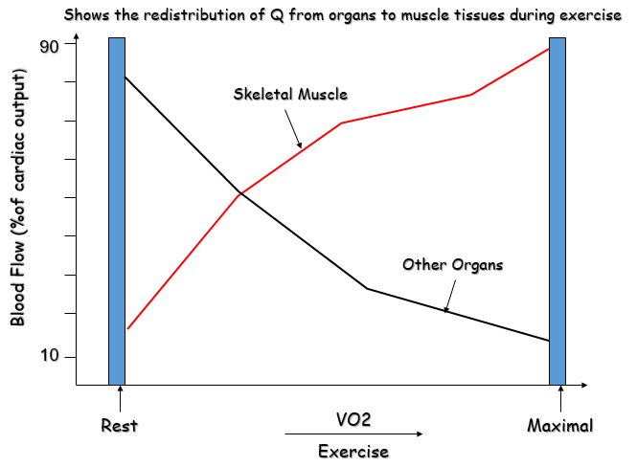
Vascular shunt mechanism
Using your knowledge from GCSE, explain the vascular shunt mechanism
Research how the vasomotor control centre helps control the vascular shunt mechanism.

