Slide 1
The respiratory system

Slide 2
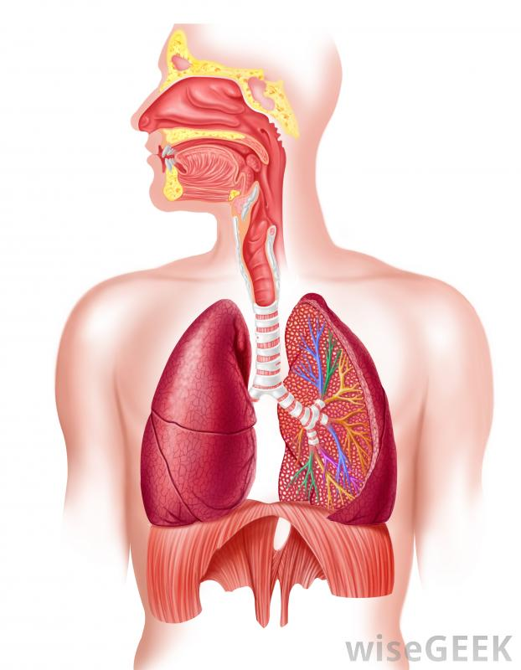
Structure of the respiratory system
Label the diagram
Trachea
Lung
Alveoli
Bronchiole
Bronchii
Pharynx
Larynx
Nasal cavity

Slide 3
Research the following terms
Breathing rate
Tidal volume
Minute ventilation
Extension – what are the average values for each of these?

Slide 4
Respiratory volume response to exercise
Research what happens to breathing rate, tidal volume and minute ventilation during exercise.

Slide 5
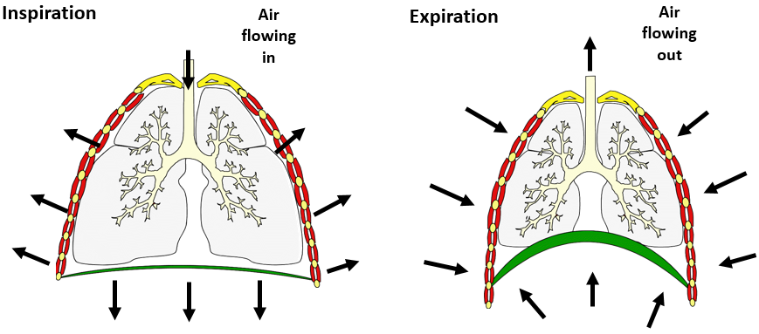
Mechanics of breathing at rest
Explain the differences between inspiration (breathing in) and expiration (breathing out) using the key words below.
External intercostals
Rib cage and sternum
Diaphragm
Volume
Pressure

Slide 6
Mechanics of breathing during exercise
Research the additional muscles recruited in inspiration during exercise
1.
2.
Research the additional muscles recruited in expiration during exercise
1.
2.

Slide 7
Respiratory regulation
Research the following and describe their role in helping to regulate our breathing:
1. Respiratory control centre
2. Inspiratory centre
3. Expiratory centre

Slide 8
Respiratory regulation during exercise
What are the roles of the following receptors in helping regulate breathing during exercise:
Chemoreceptors
Thermoreceptors
Proprioceptors
Baroreceptors

Slide 9
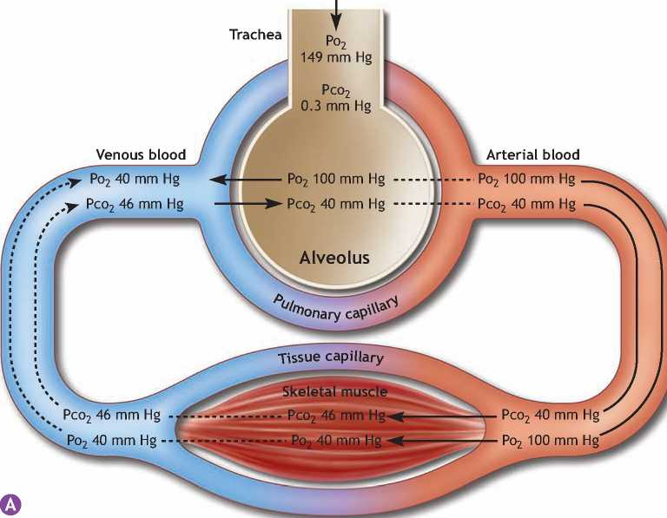
Gaseous exchange at rest
Using the diagram, can you explain how gaseous exchange occurs at the alveoli and the muscle cells

Slide 10
task
Research and summarise ‘The Bohr shift’
Extension – can you find a graph to show what this is?

