Slide 1
The Photography Bridge
Some tasks to help you prepare for Photography A-level
Task | Title | Instructions
1 | Camera and equipment | We want you to start to use a DSLR (Digital single lens reflex camera). Attached to these instructions is a letter to be sent home which is a list of the equipment you will need. Please note that you may be eligible for a bursary to help with the costs of this.
2 | Pinterest | Follow our Pinterest Boards (https://www.pinterest.co.uk/qehsp/) and discover the world of art photography. Create your own Pinterest account and then create a board with some “surfaces” research – see the task sheet for details.
7 | SURFACES | Take 46 photos to record your summer (at home or if we get away.....)
4 | Start a powerpoint | Using powerpoint start a digital sketchbook – you can see some examples here: https://queenelizabethhigh-my.sharepoint.com/:f:/g/personal/wpy_qehs_net/Ek-QSO8fK9JMlbeuGSFDTbEBCcyl23L6lg761_ZIriPLWw?e=tL3emh First make a moodboard using some of your images. Then make more pages to record some of your own photography that fits the theme 'Surfaces'
5 | Book | There are many photography books available, most of these would be very useful. The one we would recommend is: Read This If You Want To Take Good Photographs. Author: Henry Carroll. ISBN: 978-1-78067-335-6. Review is here: https://www.goodreads.com/book/show/18269594-read-this-if-you-want-to-take-great-photographs.
6 | 46 Days of summer | Taking PHOTOS is the MOST important thing – so try this project all through the holidays…. (see last slide) Take 46 photos to record your summer (at home or if we get away.....)

Slide 2
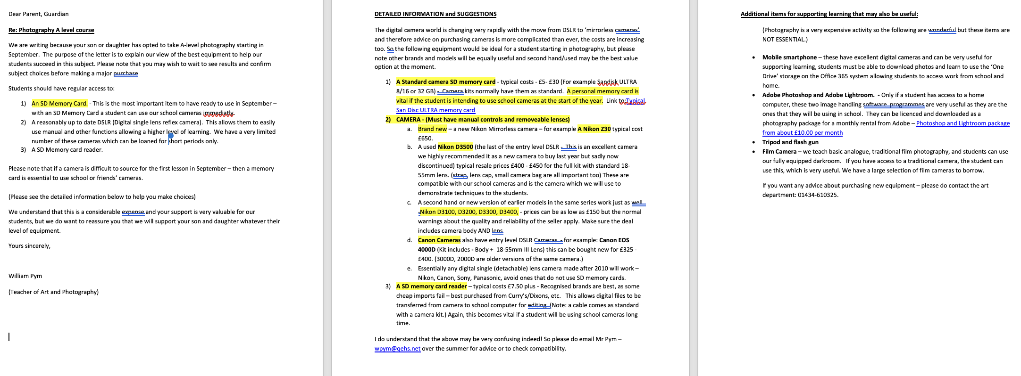
Letter for equipment here
Please note that a hard copy of this letter will be sent to every student that confirms for photography A-level in due course.
We understand that some families may wish to wait until September or even later before purchasing an expensive camera. In some cases school bursaries may apply, please ask for information from the 6th form office.

Slide 3
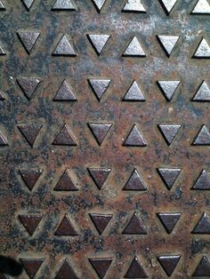
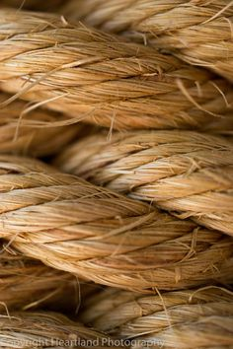
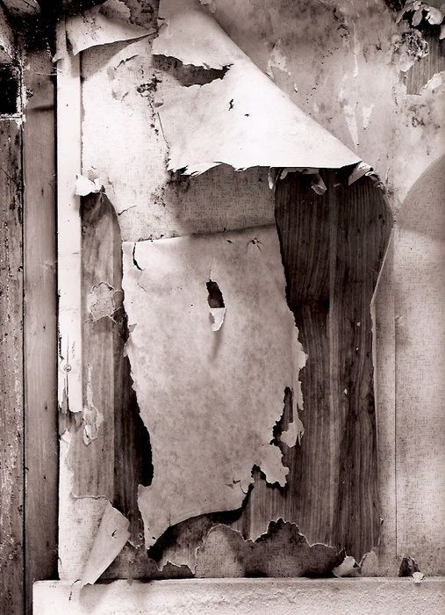
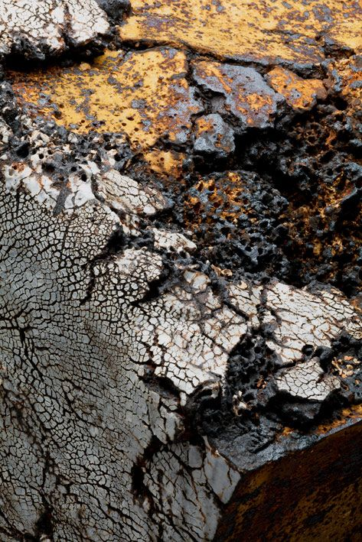
Surfaces - Photography
Task 2: Surfaces - Observational studies.
Photographers have always been fascinated by the surfaces, textures, and reflectiveness of objects and people. On your phone or camera, take at least 20 photographs showing a variety of interesting surfaces. Please consider:- 1. Quality of light (natural or artificial). 2. Composition 4. Texture, form & pattern Choose your three favourite and present them in a Powerpoint document
Task 3 Pinterest -
Start looking at the QEHS Photography Pinterest boards. Use the QEHS Pinterest site as a starting point: Look at this board in particular: https://www.pinterest.co.uk/qehsp/textures-and-surfaces-in-photography/ Create your own Pinterest account (or a new one just for photography) Create a board and collect your own selection of surfaces and textures images

Slide 4
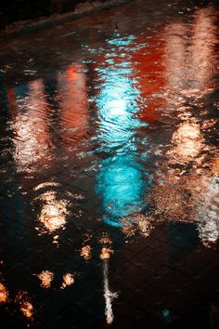
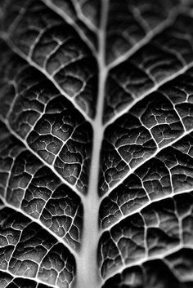
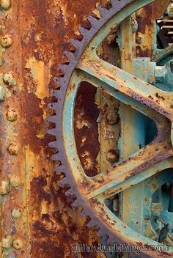
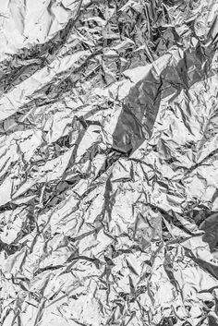
Surfaces - Photography
Task 4: Start a digital sketchbook
Using powerpoint start a digital sketchbook – you can see some examples here: Click on the link. Photography Bridging First make a moodboard using some of the images that you found on Pinterest. Then make more pages to record some of your own photography that fits the theme 'Surfaces'
Task 4 – Take some more photos in response to the images you put on your moodboard
Look in detail at the photos you chose for your moodboard. See if you can use these ideas to take more 'surfaces' photography Record these in your powerpoint.

Slide 5
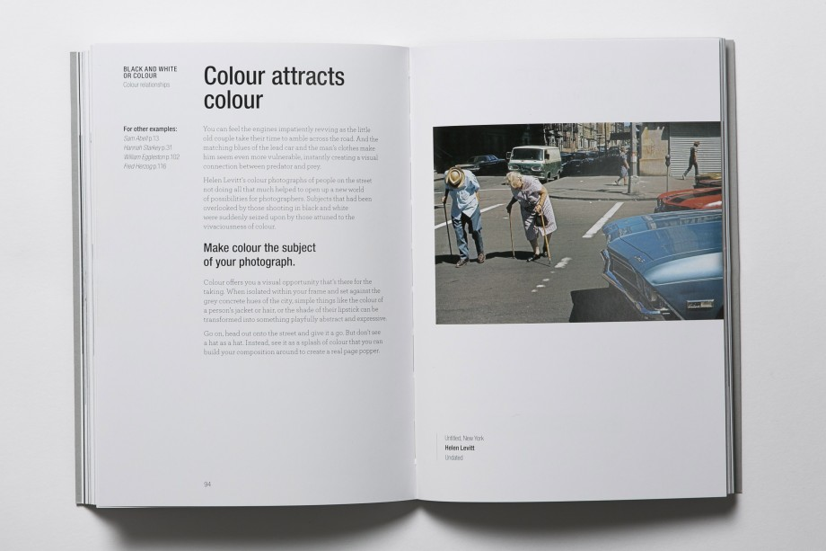
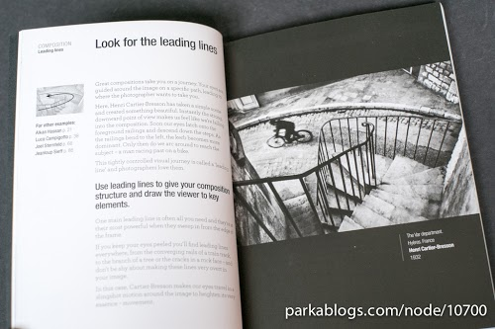
The Book we would recommend is:
Read This If You Want To Take Good Photographs.
Author: Henry Carroll.
ISBN: 978-1-78067-335-6.
Amazon link and description is here:
Click link
NOTE:
This is not a text book and it is not compulsory to buy this book. It is a recommendation and good background reading.

Slide 6
46 Days of Summer

